Slide 1
Fleminger

Slide 2
Analyses
1 Compute and interpret overall mean, CI
2. Compute and interpret heterogeneity stats
Tau-squared
I-squared
PI
3. Graph overall results with forest plot and interpret
4. Compute and interpret categorical moderator
5. Compute and interpret continuous moderator
6. Run a funnel plot with trim-and-fill and interpret
7. Compare your results to those of the published article
+

Slide 3
Fleminger Data

Slide 4
When I input OR and CI, the CMA program refused several of the rows (asymmetric CI was the error message). When I input the counts, it worked.

Slide 5
1. Overall
They ran fixed-effects
Not sure about the prediction interval. Might have to convert to log(OR) and back.

Slide 6
2. Heterogeneity
I-squared is small.
Note tau is in the metric of log(odds); hard to interpret.

Slide 7
Prediction Interval

Slide 8
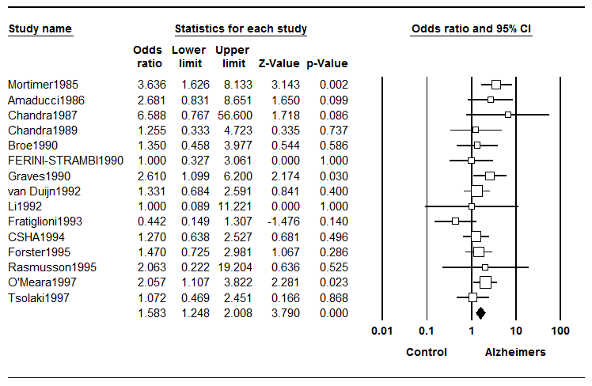
3. Graph Overall Results
CMA
PUBLISHED GRAPH

Slide 9
4. Categorical Moderator Pre vs Post Mortimer

Slide 10
4. Categorical Moderator Pre vs Post Mortimer

Slide 11
5. Continuous Moderator

Slide 12
5. Continuous moderator

Slide 13
6. Funnel Plot

