Slide 1
McLeod 2007

Slide 2
Analyses
1 Compute and interpret overall mean, CI
2. Compute and interpret heterogeneity stats
Tau-squared
I-squared
PI
3. Graph overall results with forest plot and interpret
4. Compute and interpret categorical moderator
5. Compute and interpret continuous moderator
6. Run a funnel plot with trim-and-fill and interpret
7. Compare your results to those of the published article
+

Slide 3
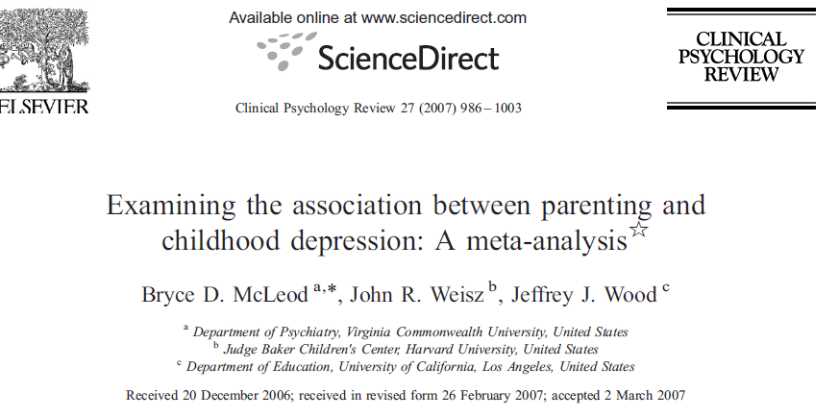
Article

Slide 4
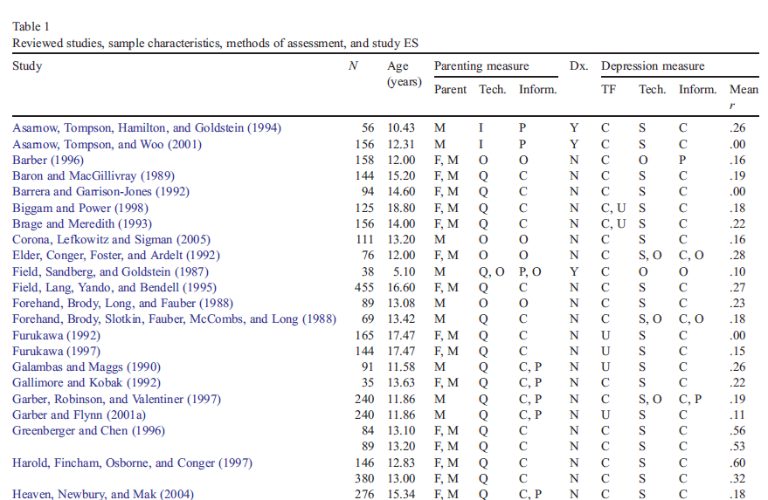
McLeod data in Table 1. Note effect size is r, but analysis will be in Fisher z.

Slide 5
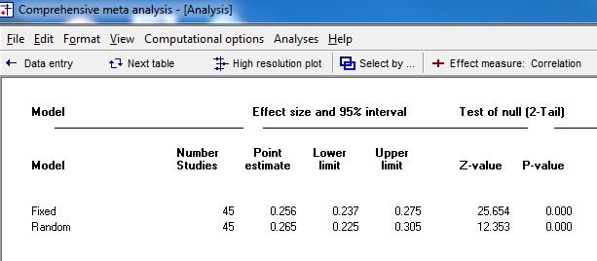
1. Overall
They ran fixed-effects

Slide 6
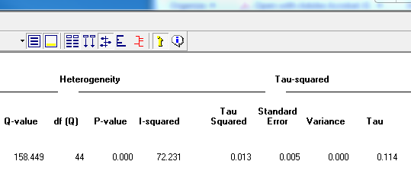
2. Heterogeneity
I-squared is moderate.
Tau is in z, but at this value of r, it is quite similar in meaning.
The value .11 is moderate for social science, but consider the implication of moving up and down .22 from .27.

Slide 7
Prediction Interval

Slide 8
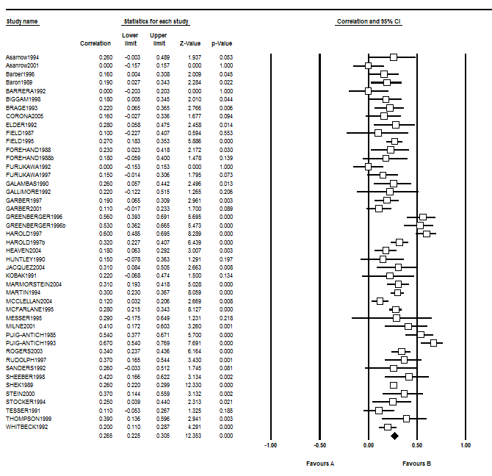
3. Graph Overall Results
CMA

Slide 9
4. Categorical Moderator Diagnosis of depression (Y, N)

Slide 10
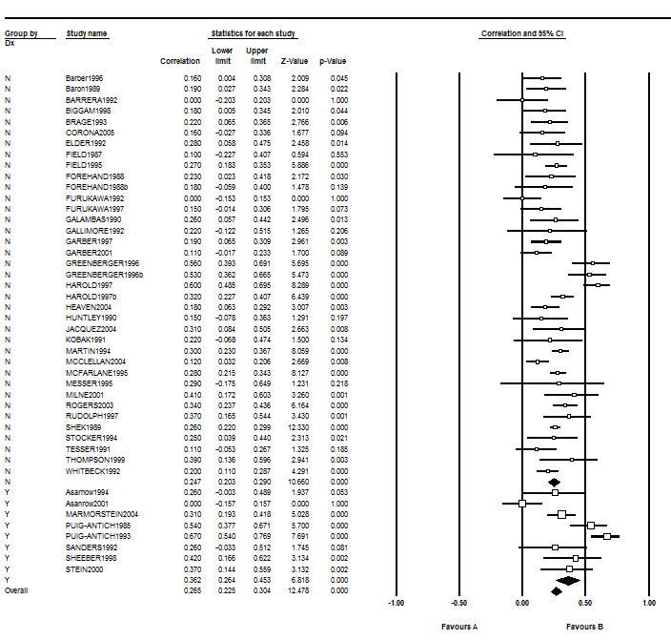
Graph of Categorical
Moderator

Slide 11
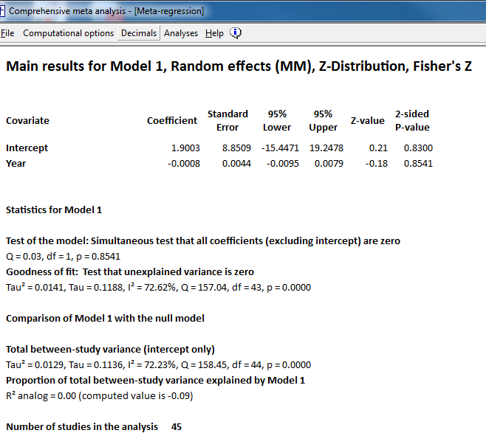
5. Continuous Moderator

Slide 12
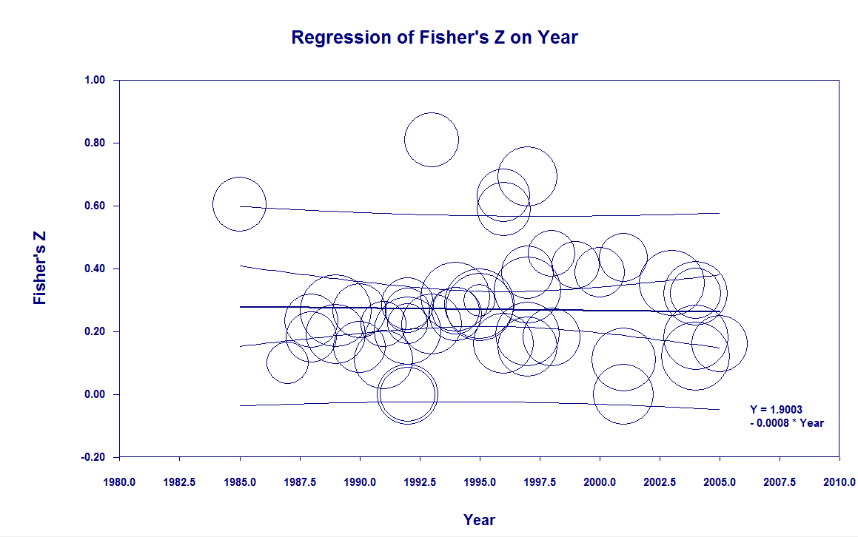
5. Continuous moderator

Slide 13
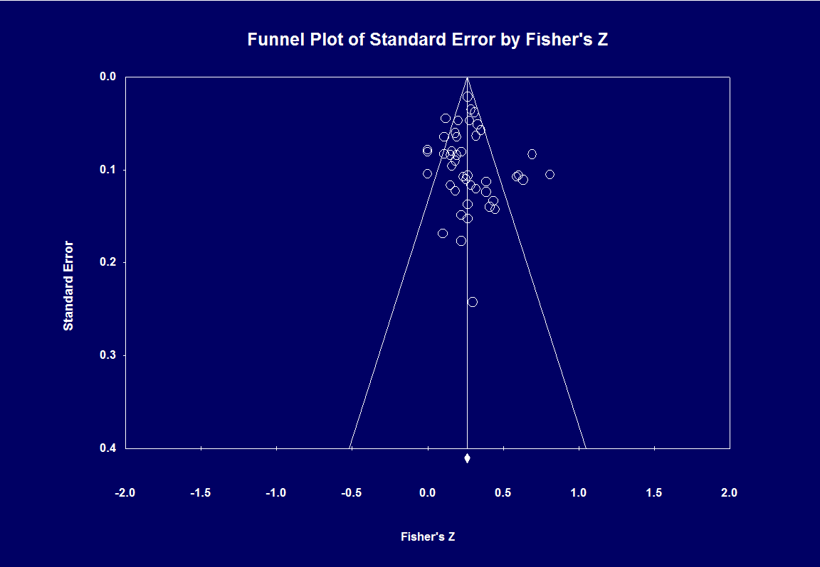
Funnel Plot.
Trim & Fill says no imputed
Studies.

