Slide 1
Meta-analysis Overview
Michael T. Brannick, University of South Florida
Workshop for Eotvos Lorand University, Budapest 2016

Slide 2
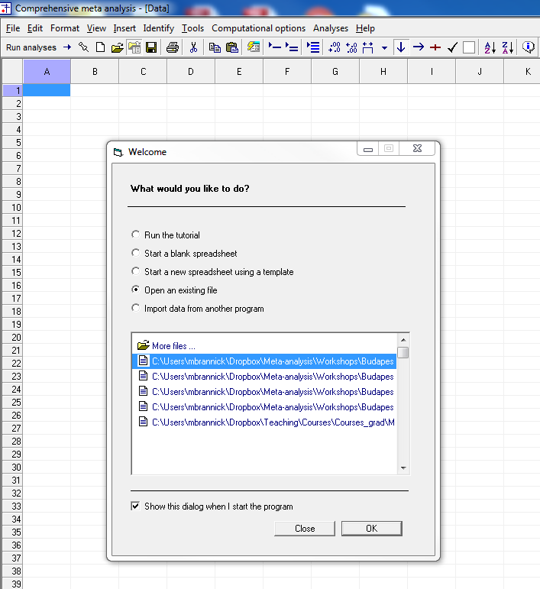
Meta-Analysis
What is it?
Quantitative analysis of study outcomes
Analysis of effect sizes
Ordinary data analysis except known precisions
Software we will use is called CMA or Comprehensive Meta Analysis.

Slide 3
Steps
Research question or Study aims
Search & eligibility
Coding, computation of effects, conversions
Analysis
Overall
Moderators
Graphs
Sensitivity
Discussion

Slide 4
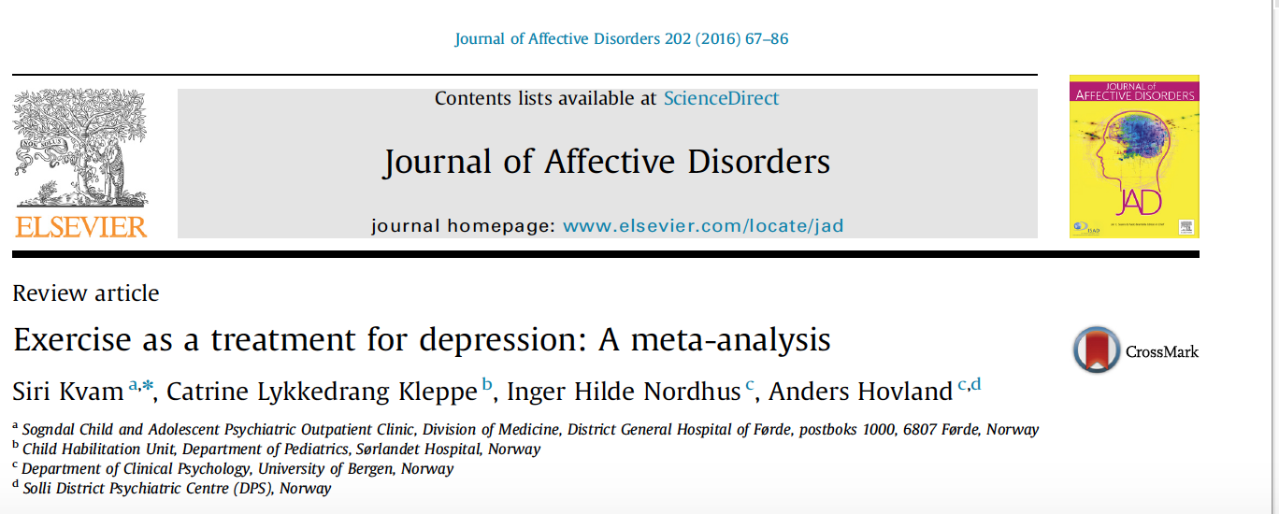
Illustrative Study: Kvam et al. (2016)

Slide 5
Research Question
Is exercise an effective treatment of depression compared to control (wait list)?
Is exercise an effective adjutant treatment to conventional treatment (e.g., beyond drugs)?
Research question or Study aims
Search & eligibility
Coding, computation of effects, conversions
Analysis
Overall
Moderators
Graphs
Sensitivity
Discussion

Slide 6
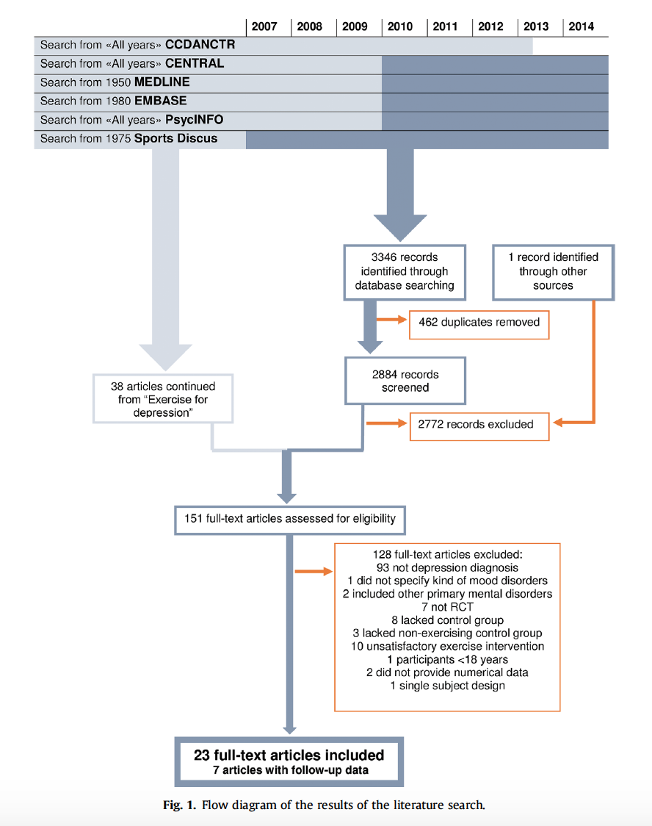
Search & Eligibility
Your search should be replicable. A flow diagram (see PRISMA) is a good way to communication your decisions to the reader and to future meta-analysts in the same domain. KEEP RECORDS OF THE PROCESS – VERY HARD TO CREATE DIAGRAM AFTER THE FACT.
Additional criteria for eligibility – participants with a unipolar depression diagnosis, study has a no-exercise control group, etc. Some journals require you to list those articles you excluded, so keep a database along the way. You will also want some indication of decision agreement among your coders, so keep records of that, too.

Slide 7
Coding, Computing, Converting
Meta-analysis requires effect sizes as data points.
Many journals now require the inclusion of effect sizes, but many articles do not have them.
Articles may report an effect size different from the one you want
Articles may report data that you can convert to an effect size you want
CMA is good at conversions
Research question or Study aims
Search & eligibility
Coding, computation of effects, conversions
Analysis
Overall
Moderators
Graphs
Sensitivity
Discussion

Slide 8
Common Effect Sizes
Standardized Mean Difference (SMD). Similar to z score
Pearson product-moment correlation coefficient
 | Events | Non-Events
Treated | A | B | n1
Control | C | D | n2
 |  |  | Total

Slide 9
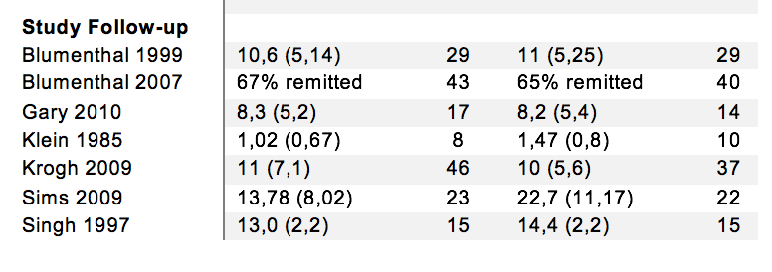
Data
Need a common scale.
Exercise
Control
Binary
Scales

Slide 10
Analysis 1 – model choice
Fixed vs. random effects
Random generally more appropriate
Random-effects variance component (REVC; tau-squared), heterogeneity, Chi-squared (Q) & I-squared
Random-effects weights
Confidence and Prediction Intervals
Research question or Study aims
Search & eligibility
Coding, computation of effects, conversions
Analysis
Overall
Graphs
Moderators
Sensitivity
Discussion

Slide 11
Analysis 2 – model specifics
Used Comprehensive Meta-Analysis (CMA) for data analysis
Specified random-effects
Specified Hedge’s g as effect size (SMD with bias correction)
Heterogeneity – Q(chi-squared) and I-squared

Slide 12
Analysis 3 – overall (summary) results
Number of studies, k = 23, total people, N = 977
Overall mean: g = -.68, CI = [-.92 to -.44]; moderate to large effect size (people in exercise condition were less depressed)
Heterogeneity: Q(22) = 68.74, p <.001. I-squared = 67.99; moderate to large heterogeneity
Did not report REVC or prediction interval, but they should have. They underestimated the importance of heterogeneity. Will show you how to avoid this.
Research question or Study aims
Search & eligibility
Coding, computation of effects, conversions
Analysis
Overall
Graphs
Moderators
Sensitivity
Discussion

Slide 13
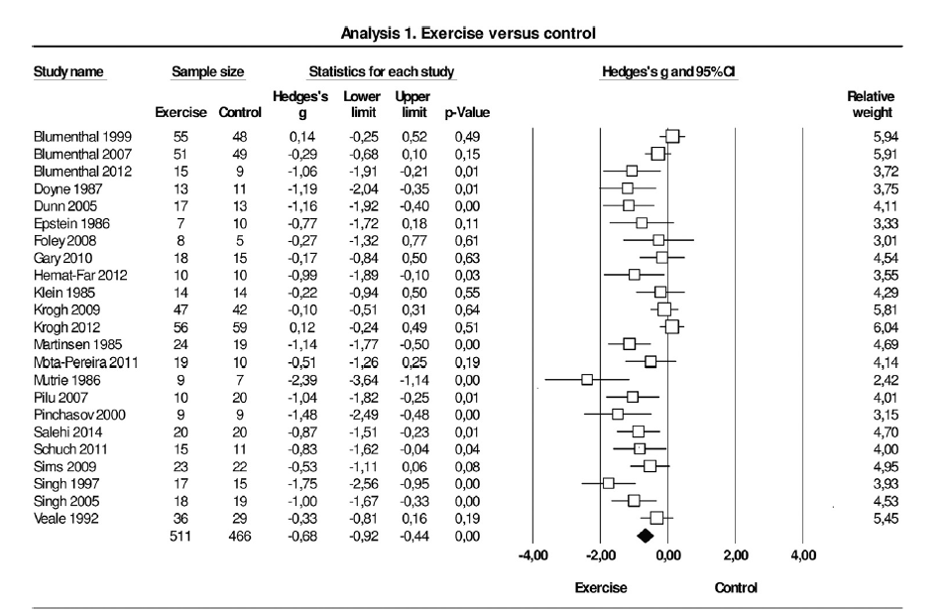
Graphs 1
Forest Plot
Overall results
Study information
Forest plot symbols
Overall mean
Will show you how to create these with CMA.

Slide 14
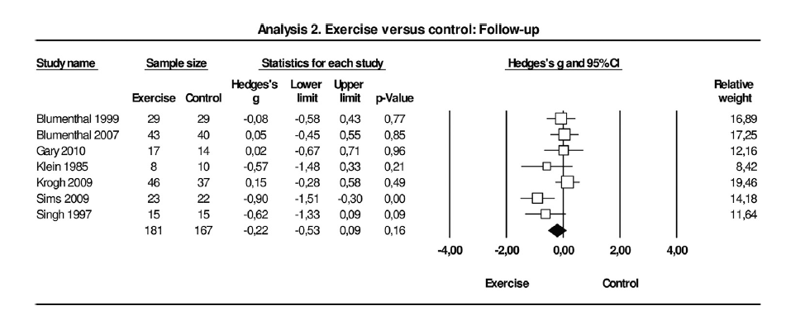
Graphs 2 – follow up
Note that the effect sizes are small, but we do not know what happened to the means pre-post for the two groups. Need an extra graph or table.

Slide 15
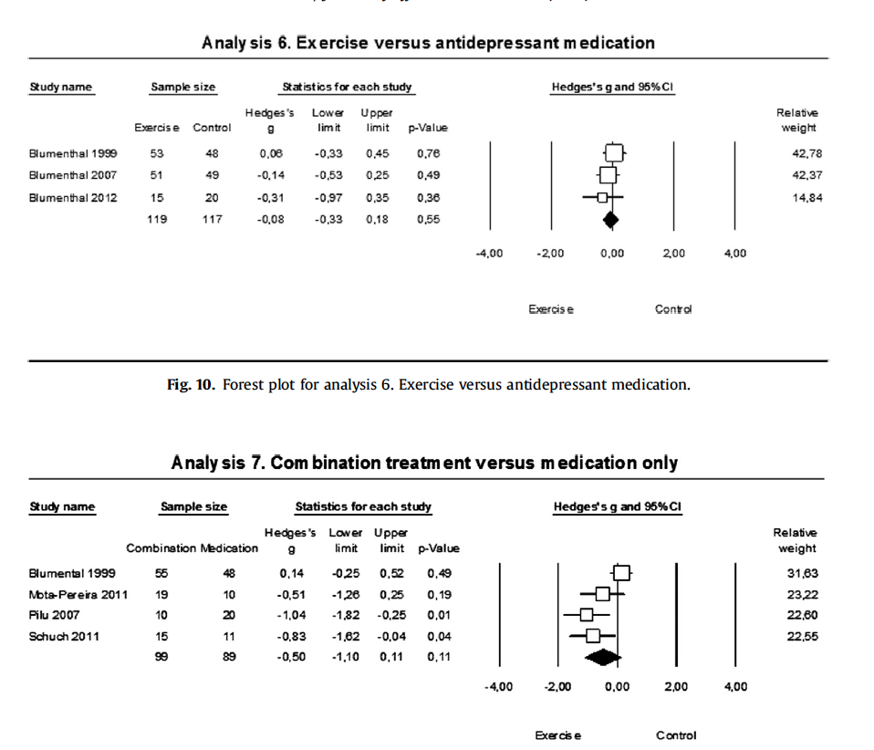
Graphs 3
Some indication that exercise is about as effective as medication and that it may add to effects beyond medication. Too few studies to be conclusive.

Slide 16
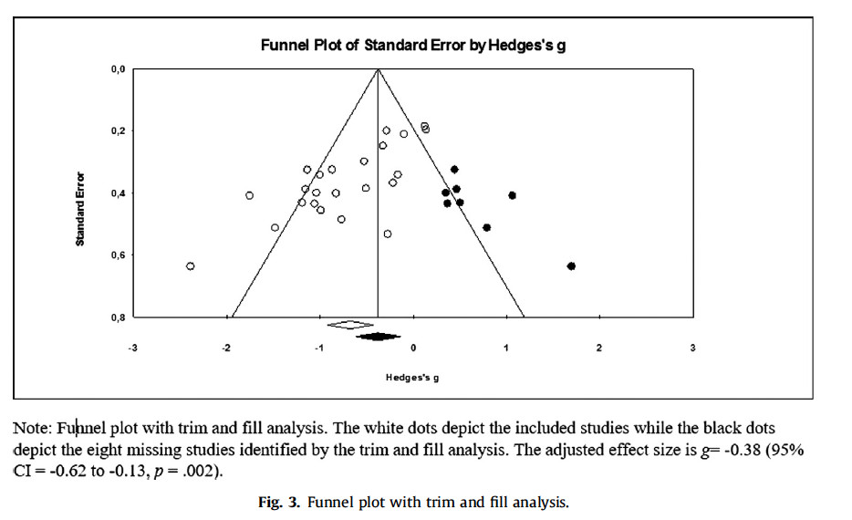
Graphs 4
Funnel Plot
Trim-and-fill is one kind of sensitivity (what if?) analysis.

Slide 17
Moderator (categorical)
Research question or Study aims
Search & eligibility
Coding, computation of effects, conversions
Analysis
Overall
Graphs
Moderators
Sensitivity
Discussion
They noted a significant difference between subgroups. No blinding -> bigger effect.

Slide 18
Sensitivity
Trim-and-fill
With multiple-arm studies, chose the arm with the largest effect (failed to ask ‘what if?’)
Did not report any adjustment for outliers or differences in coder judgment
Research question or Study aims
Search & eligibility
Coding, computation of effects, conversions
Analysis
Overall
Graphs
Moderators
Sensitivity
Discussion

Slide 19
Discussion
Paragraph saying what is new and different
Overall, exercise effective
Difference between blinded and not
Publication bias analyses suggest overall difference smaller, but still there
Difference for control but not for conventional treatment (CBT etc.)
Effects of exercise diminish after treatment ends
Need effectiveness studies, and studies of patient adherence
Research question or Study aims
Search & eligibility
Coding, computation of effects, conversions
Analysis
Overall
Graphs
Moderators
Sensitivity
Discussion

Slide 20
Critique
Nice job with:
Flow chart
Search terms & data in appendix
Random-effects model
Graphs
Publication bias and study quality (blinding) assessments
Logical next steps and where studies are needed
Could have improved by:
Prediction intervals and REVC (plausible to get no true effect studies)
Graph of pre and post means for follow up
Rater (coder) reliability: percent agree, kappa, ICC
Multiple arms – chose largest

Slide 21
Plan for tomorrow
Lecture on statistical theory balanced by skill acquisition in CMA
Series of modules punctuated with computer exercises, mostly using Kvam data
1. Download data, open CMA
2. Searching for & coding studies
3. Common effect sizes (d, r, OR)
4. Data input for CMA
5. Dependent effect sizes
6. Data analysis – fixed- and random-effects
7. How CMA estimates the mean (inverse variance weights)
8. Heterogeneity (Q, I-squared, tau-squared)
9. Prediction and confidence intervals
10. Graphs – forest plot & funnel plot; trim & fill
11. Moderators – categorical and continuous
12. Sensitivity analysis
13. Second dataset for practice (either correlation or odds ratio)

