Slide 1
Meta-analysis Workshop
Michael T. Brannick, University of South Florida
Workshop for Eotvos Lorand University, Budapest 2016

Slide 2
Datasets
Kvam (2016) – Exercise as treatment for depression
Effect size = d
K = 23
Categorical moderator
McLeod (2007) – Association between parenting and childhood depression
Effect size = r
K = 45
Continuous and categorical moderators
Fleminger (2003) – Association between head injury and Alzheimer’s disease
Effect size = OR
K = 15
Continuous and categorical moderators

Slide 3
Open Software
CMA – can you get to the first screen?
Internet Browser
http://faculty.cas.usf.edu/mbrannick/meta/index.html
Download Kvam dataset, save to desktop, open with CMA (next slide)
If you want, download Workshop PowerPoints, Open PowerPoint
For those using CMA, companion book recommended:
Borenstein, M., Hedges, L. V., Higgins, J. P. T., & Rothstein, H. R. (2009). Introduction to meta-analysis. Chichester, UK: Wiley

Slide 4
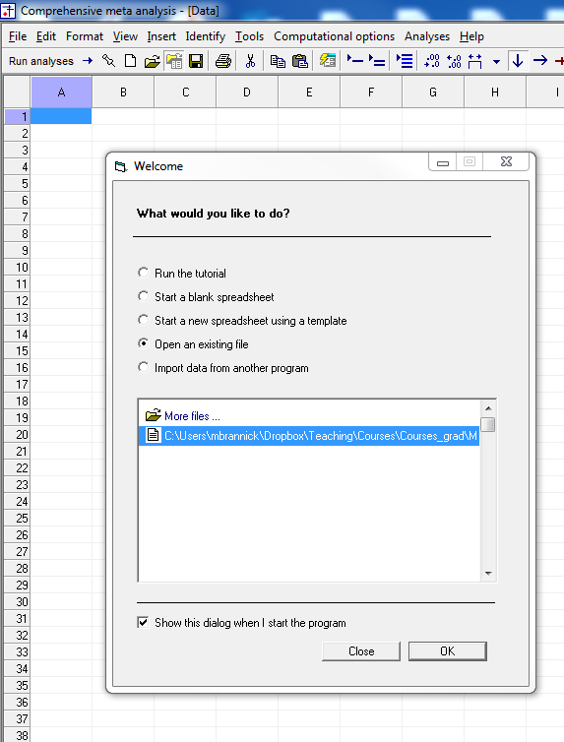
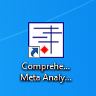
1
Open CMA, load Kvam
2
Kvam.cma
3

Slide 5
Meta-analysis
Pros
Cons
Power to detect summary effect
Replicable, persuasive reviews
Tests of moderators
Sensitivity and bias evaluations
Highly cited pubs without primary data collection
Apples & Oranges
GIGO
Premature termination of research area
Insufficient studies

Slide 6
Steps
Research question or Study aims
Search & eligibility
Coding, computation of effects, conversions
Analysis
Overall
Graphs
Moderators
Sensitivity
Discussion

Slide 7
Research Question
Define Constructs (what is the domain?)
Therapy effectiveness
Integrity tests
Research Question
What’s the average effect size? Is it zero?
Moderator or boundary condition? Impact of management (e.g., Brown*)
Effect dissipates over time?
May or may not be summary of a literature
Theoretical Justification of Moderators
Pick ONE study type (e.g., experiment, correlational study) or pick all and analyze separately.
*Brown, S. (1981). Validity generalization and situational moderation in the life insurance industry. Journal of Applied Psychology, 66, 664-670.

Slide 8
Research Question - Kvam
Is exercise an effective treatment of depression compared to control (wait list)?
Is exercise an effective adjutant treatment to conventional treatment (e.g., beyond drugs)?
Research question or Study aims
Search & eligibility
Coding, computation of effects, conversions
Analysis
Overall
Graphs
Moderators
Sensitivity
Discussion

Slide 9
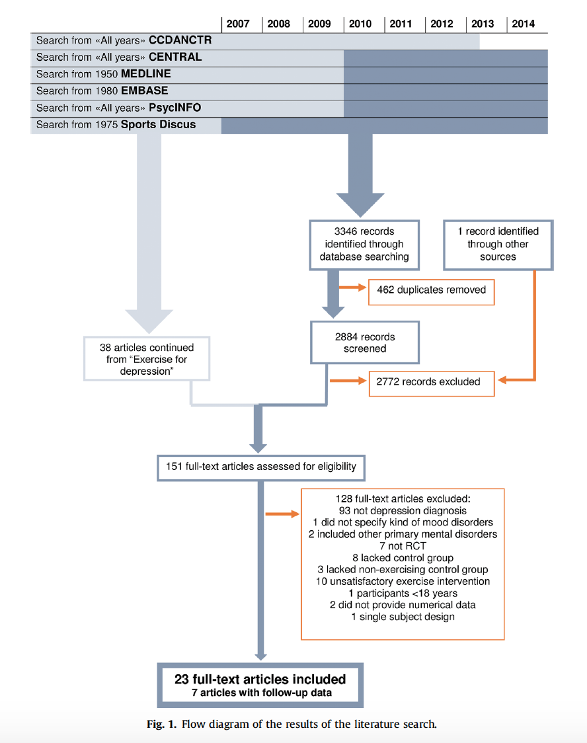
Kvam Eligibility
A flow diagram (see PRISMA) is a good way to communication your decisions to the reader and to future meta-analysts in the same domain.
Additional criteria for eligibility:
- participants with a unipolar depression diagnosis
- study has a no-exercise control group
Exclusions

Slide 10
Coding, Computing, Converting
Meta-analysis requires effect sizes as data points. Analysis requires one common effect size across studies, e.g., d or r
Many journals now require the inclusion of effect sizes, but many articles do not have them.
Articles may report an effect size different from the one you want, but you can convert to an effect size you want; keep track of original metric (code it)
CMA is good at conversions
Research question or Study aims
Search & eligibility
Coding, computation of effects, conversions
Analysis
Overall
Graphs
Moderators
Sensitivity
Discussion

Slide 11
Recommendations for coding
Create a database to keep track of your search and decisions
Create a PRISMA flowchart; hard to do this if you don’t keep good records
I use Excel, but any database will do
Track the article and its disposition
Use 2 coders on some or all of the articles to show reliability
Get agreement on everything that is coded

Slide 12
Example Search Setup
During the first (or maybe second) pass, you will be looking to see whether there are sufficient data to include the study in your meta-analysis. When in doubt, keep the study and look up conversions.

Slide 13
Record keeping

Slide 14
Common Effect Sizes
Standardized Mean Difference (SMD). Similar to z score
Pearson product-moment correlation coefficient, where z = $\frac{X−\overline{X}}{SDX}$
 | Events | Non-Events
Treated | A | B | n1
Control | C | D | n2
 |  |  | Total

Slide 15
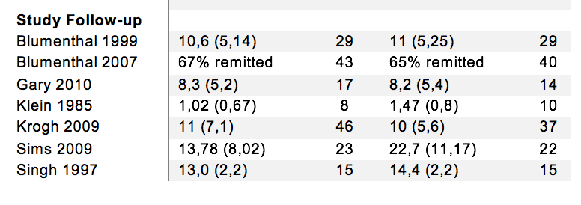
Kvam Data
Exercise
Control
Binary
Scales

Slide 16
CMA data input
Create a column for study ID – each study needs a unique ID
Kingsly 2006a, Kingsly 2006b, etc.
Separate, additional column for year to see time effect
Create column for effect size data
Dialog on what kind of data
Be careful to be consistent on direction of effect size!
Create separate columns for different kinds of effect sizes
CMA will convert them for you
You can use Excel or other programs to convert effect sizes instead of CMA (generally not necessary)

Slide 17
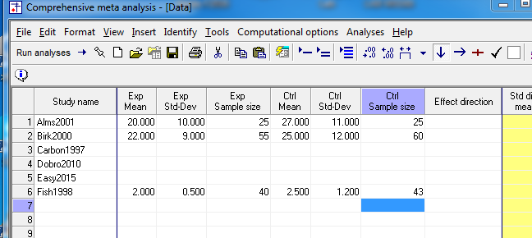
CMA Exercise (1)
Find a partner. Close Kvam.cma
Download InputExcercise.xlsx and open it; create blank page (new project) for CMA
Insert -> column for -> study names (type in study names Alms thru Fish)
Insert -> column for -> effect size data -> next -> comparison of 2 groups ->
next-> continuous (means) -> unmatched data, posttest only – >
Mean, SD and N each group -> finish
First group gets Exp, second group gest Ctrl.
Then type in →
Effect direction (set to positive)

Slide 18
Input Exercise continued (2)
Insert -> column for -> effect size data -> sample size and t
Input data for Easy; note we will assume equal N per group df = 58 so Ntotal=60

Slide 19
Input Exercise continued (3)
Insert -> column for -> effect size data -> Cohen’s d and sample size -> finish
We have now typed in all the data. CMA will analyze Hedge’s g, which is the unbiased estimator of the Standardized Mean Difference (SMD).

Slide 20
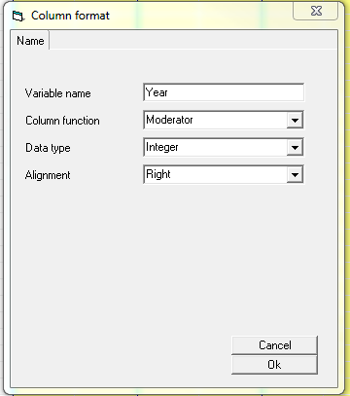
Input Exercise continued (4)
Insert -> column for -> moderator; type in a year for each study
After success, close the practice exercise.

Slide 21
Dependent Data
Problem of dependent data
Double counting
CMA is made for independent effect sizes; need other programs for dependencies
If you have independent sets of people in a study, code them as separate studies or as subgroup within study in Moderator column
Males vs Females
Clinical Diagnosis vs. controls
If you have multiple Dependent Variables on the same people
Simple average
Treat in separate analysis, but use average in overall summary analysis
Weight by covariance (see Borenstein et al., 2009, but I do not recommend this)

Slide 22
Break
Coming up next
Fixed vs. Random Effects in Data Analysis

Slide 23
Analysis 1 – model choice
Fixed vs. random effects
Random generally more appropriate
Random-effects weights
Heterogeneity, Chi-squared, REVC & I-squared
Confidence and Prediction Intervals
Research question or Study aims
Search & eligibility
Coding, computation of effects, conversions
Analysis
Overall
Moderators
Graphs
Sensitivity
Discussion

Slide 24
Fixed and Random Effects 1
All conditions of interest – Fixed. Sample of interest – Random.
Both fixed and random-effects meta-analyses attribute some observed variance in ES to sampling error.
The residual variance after accounting for sampling error (and maybe other variables) is called random-effects variance. REVC is the random-effects variance component.
CMA calls the REVC tau-squared - τ^{2.}
Problem is that our interest is random – want to generalize beyond current sample, but our observations (studies) are not a random sample. Data are problematic for the kind of inference we want to make.
For clear statements about fixed vs. random:
Viechtbauer W: Conducting meta-analysis in R with the metafor package. Journal of Statistical Software 2010, 36(3):1-48.
Bonett DG: Meta-analytic interval estimation for Pearson correlations. Psychological Methods 2008, 13:173-189.

Slide 25
Fixed vs. Random 2
In the literature, fixed vs random is confused with common vs. varying effects meta-analysis.
Common effect MA – only a single population parameter
Varying effects MA – parameter has a distribution (typically assumed to be Normal)
I will typically not distinguish, either- random means varying, fixed means common
Mixed Model
Fixed Moderators (aka covariates)
Remaining (random-effects) variance

Slide 26
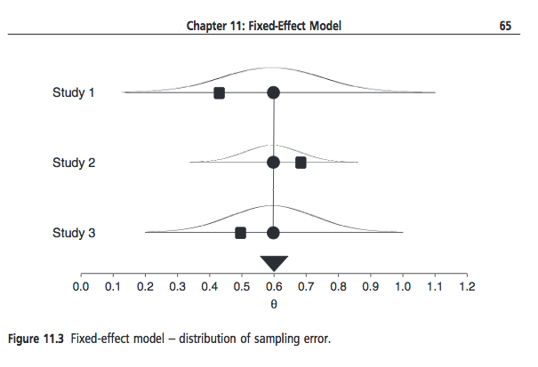
Fixed (Common) Effect
Observed effect size
Underlying parameter
Sampling error is sole source of variance in observed effect sizes.
e.g., effect of color saturation on discrimination judgments of color patches (same vs different) in different countries
Borenstein et al., 2009, pp. 64-65

Slide 27
Random (Varying) Effects
Sampling error is one source of variance in effect sizes. But the ’true’ effect sizes also vary. The variance of
‘true’ or infinite-sample effect sizes is the random-effects variance component (REVC).
e.g., effect of mindfulness meditation on well being in different countries
REVC is the variance of this distribution, the distribution of circles, not squares.
Borenstein et al., 2009, p. 72.

Slide 28
Random-Effects Model Choice
Random
fixed
1. Better fits the question of interest
2. More realistic assumption
3. Honest communication of sources of uncertainty
4. If REVC is small to zero, gives same results as fixed.
1. Customary meaning of overall ES - mean
2. CI is narrow in fixed, so power is better with fixed for test of overall mean
3. If REVC is large, fixed-effects results will be misleading.

Slide 29
How CMA computes the mean
CMA follows the Hedges-Olkin tradition
Computations detailed in Borenstein et al., 2009
Mean is a weighted average
For fixed effects, weights are study precisions (inverse of the sampling variance for each study)
For random effects, weights are study precisions discounted for REVC (closer to unit weights depending on size of REVC)

Slide 30
Mean Difference (Standardized)
Spooled is the pooled Standard deviation. Note that the variance of d depends upon the magnitude of d (actually delta, estimated by d).

Slide 31
Mean Difference (Standardized)
Bias correction:
Formulas from Borenstein et al., 2009, p. 27
The effect size d is sometimes called ‘Cohen’s d’ and the effect size g is sometimes called ‘Hedges’ g’ but in practice they are essentially the same. It is now conventional to use g. Study precision weight is 1/Vg, the inverse of the sampling variance of g.

Slide 32
Correlation (Pearson’s r)
Fisher’s r to z transformation.
The Hedges camp uses the r to z transformation to analyze correlations as effect sizes. After the calculations for the meta-analysis, the results must be back translated to r. This conversion is somewhat controversial. Pay attention to whether results are in r or z. The study precision weight is Ni-3.

Slide 33
Binary - odds ratio
 | Events | Non-Events
Treated | A | B | n1
Control | C | D | n2
 |  |  | Total
The Hedges camp transforms the odds ratio to log odds for the analysis (not controversial). After the calculations for the meta-analysis, the results must be back translated to odds. The study precision weight is 1/V(logOddsRatio). Pay attention to whether your results are transformed or not.

Slide 34
How to Combine (2)
Take a weighted average
Study | ES | W (weight) | W(ES)
1 | 1 | 1 | 1
2 | .5 | 2 | 1
3 | .3 | 3 | .9
M=(1+1+.9)/(1+2+3)
M=(2.9)/6
M=.48
(cf .6 w/ unit wt)
In meta-analysis, the most influential studies have the smallest errors, i.e., the most information.
(Unit weights are special case where w=1.)

Slide 35
CMA weighted averages
Statistic | Effect Size | Weight (fixed) | Weight (random)
Standardized Mean Difference |  | W = 1/Vg | W* = 1/(Vg+REVCg)
Correlation |  | W = 1/Vz | W* =1/(Vz+REVCz)
Odds Ratio | $$\ln{OR}=\log_{e}\left(\frac{A/B}{C/D}\right)$$ | W = 1/V(lor) | W* = 1/(Vlor+REVClor)
With random-effects, there are 2 sources of uncertainty that affect the amount of information in each study.

Slide 36
Standard Errors
For the overall effect size, we want standard errors and confidence intervals
Model | Mean (M) | Standard Error (SEM) | Confidence Interval (95CI)
Fixed | $M=\frac{\sum{wES}}{\sum{w}}$ | $SEM=\frac{1}{\sqrt{\sum{w}}}$ | $95CI=M±1.96SEM$
Random | $M=\frac{\sum{w^{∗}ES}}{\sum{w^{∗}}}$ | $$SEM∗=\frac{1}{\sqrt{\sum{w∗}}}$$ | $95CI=M±1.96SEM∗$

Slide 37
Where we are
Research question or Study aims
Search & eligibility
Coding, computation of effects, conversions
Analysis
Overall
Moderators
Graphs
Sensitivity
Discussion

Slide 38
CMA Exercise 2
Run the Kvam data both fixed and random
Select the posttest only (pre) studies; exclude the follow-ups
Compare the overall mean for fixed and random
Compare the confidence interval for the mean for fixed and random
Compare your results to published results:
Number of studies, k = 23, total people, N = 977
Overall mean: g = -.68, CI = [-.92 to -.44]; moderate to large effect size

Slide 39
Run analyses

Slide 40
This is not what you want because it has all the studies included (both posttest and follow-up). Luckily, you have coded for pre vs post and have input that as a moderator. You want to exclude follow-up studies.

Slide 41
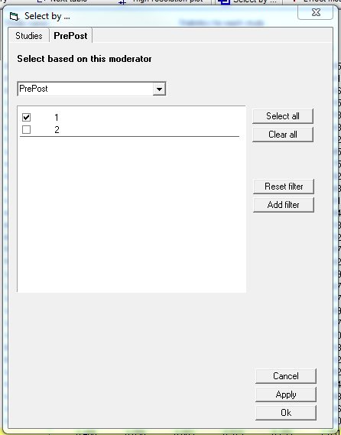
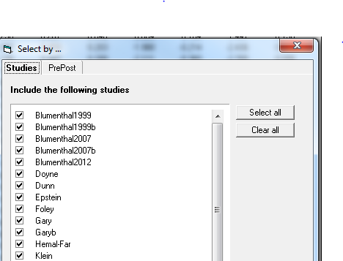
After run analyses -> Select by… ->
PrePost (the name of the moderator) ->
uncheck box 2 -> Apply -> Ok

Slide 42
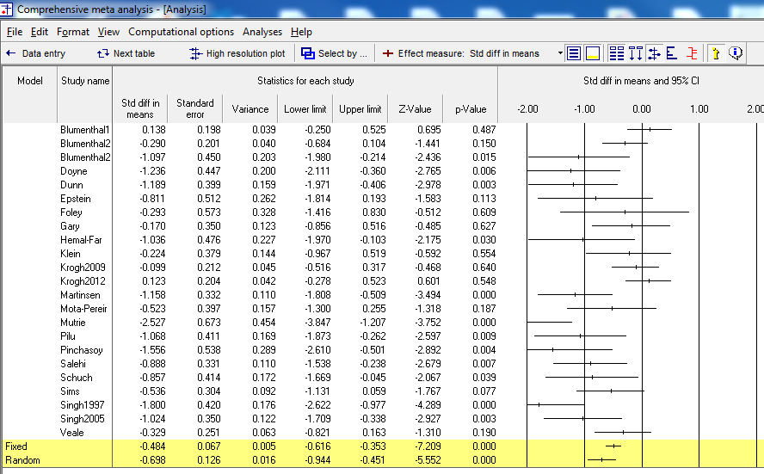
Go to bottom left ->
both models. You get
Fixed and Random
Then
-> Next table

Slide 43
Results
Compare the overall mean for fixed and random
Compare the confidence interval for the mean for fixed and random
Compare your results to published results:
Number of studies, k = 23, total people, N = 977
Overall mean: g = -.68, CI = [-.92 to -.44]; moderate to large effect size

Slide 44
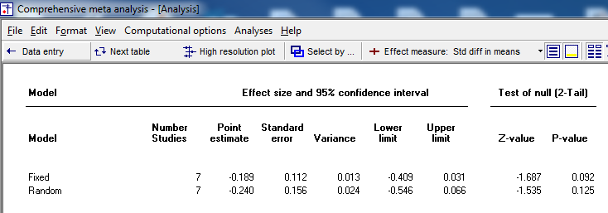
Run the same for the Follow-up Studies

Slide 45
Break
Coming up next ->
Heterogeneity (Overall Analysis)

Slide 46
Heterogeneity
How much variability in effect sizes?
How much due to sampling error?
How much due to random effects?

Slide 47
Homogeneity Test
$$Q=\sum{w{\left(ES−\overline{ES}\right)}^{2}}$$
Q is a weighted sum of squares. When the null (homogeneous rho) is true, Q is distributed as chi-square with (k-1) df, where k is the number of studies. Allows computation of probability of large sum. This supports a test of whether Random Effects Variance Component is zero.

Slide 48
Estimating the REVC
Q is a weighted sum of squares
If REVC estimate is less than zero, set to zero.
T-squared estimates tau-squared. Note that the fixed-effects weights are always used in the computation of Q and REVC.

Slide 49
Random-Effects Weights
Inverse variance weights give weight to each study depending on the uncertainty for the true value of that study. For fixed-effects, there is only sampling error. For random-effects, there is also uncertainty about where in the distribution the study came from, so 2 sources of error. The InV weight is, therefore:

