Slide 1
Testing for moderators
A moderator is a third variable that conditions the relations between 2 others. Because effect sizes are the relations between 2 variables, any variable that predicts the effect sizes is a moderator.
Categorical
Continuous
Fixed vs. Mixed
Research question or Study aims
Search & eligibility
Coding, computation of effects, conversions
Analysis
Overall
Graphs
Moderators
Sensitivity
Discussion

Slide 2
Number of Independent Variables
In theory, a meta-analysis model can contain both continuous and categorical moderator variables.
In theory, a model can contain an unlimited number of independent variables – statistical control for IVs
In practice, independent variables are usually modeled one at a time, and there are often only a few IVs (should be theory-driven)
There are problems with missing data and capitalization on chance.
Often both Type I and Type II errors – many small k analyses

Slide 3
Categorical Moderator Example
Correlation of SAT and Grades for Males (studies 1-3)
and Females (studies 4-6)

Slide 4
Hypothetical SAT data
Study | r | z | N | w | Sex
1 | .40 | .42 | 200 | 197 | M
2 | .42 | .45 | 175 | 172 | M
3 | .45 | .48 | 250 | 247 | M
4 | .60 | .69 | 250 | 247 | F
5 | .55 | .62 | 200 | 197 | F
6 | .65 | .78 | 225 | 223 | F
What is the correlation overall? Is it different for males and females?

Slide 5
Study | z | w | w**2 | w*z | w*(z-zbar)**2
1 | .42 | 197 | 38809 | 83.46 | 4.90
2 | .45 | 172 | 29584 | 77.00 | 3.07
3 | .48 | 247 | 61009 | 119.72 | 2.31
4 | .69 | 247 | 61009 | 171.21 | 3.09
5 | .62 | 197 | 38809 | 121.82 | 0.27
6 | .78 | 223 | 49284 | 172.12 | 8.35
Sum |  | 1282 | 278504 | 745.33 | 21.99

Slide 6
Male Subset
Study | z | w | w**2 | w*z | w*(z-zbar)**2
1 | .42 | 197 | 38809 | 83.46 | .192
2 | .45 | 172 | 29584 | 77.00 | .009
3 | .48 | 247 | 61009 | 119.72 | .220
Sum |  | 616 | 129402 | 280.18 | .421

Slide 7
Female Subset
Study | z | w | w**2 | w*z | w*(z-zbar)**2
4 | .69 | 247 | 61009 | 171.21 | .007
5 | .62 | 197 | 38809 | 121.82 | 1.26
6 | .78 | 223 | 49284 | 172.12 | 1.31
Sum |  | 666 | 149102 | 465.14 | 2.58

Slide 8
Test of Moderator
 | Total | Male | Female
Zbar | .58 | .45 | .70
Q | 21.99 | .42 | 2.58
The test of the moderator is the test of Q_{B}. The test has df = (Number groups –1). Here df=1, Q_{B}=18.99, p<.05. Moderator tests are based on fixed-effects analyses.

Slide 9
Group Means
Group | Sum (w) | SE | zbar | CI 95L | CI 95U | rbar | CI 95L | CI 95U
Male | 616 | .040 | .45 | .38 | .53 | .43 | .36 | .49
Female | 666 | .039 | .70 | .62 | .77 | .60 | .55 | .65
Total | 1282 | .028 | .58 | .53 | .64 | .52 | .48 | .56
Note that the difference in means is .25, which is quite large (and hypothetical; fictional data).
Note also that we have a choice in whether to pool REVC when estimating group means for mixed model. Residual REVC is used.

Slide 10
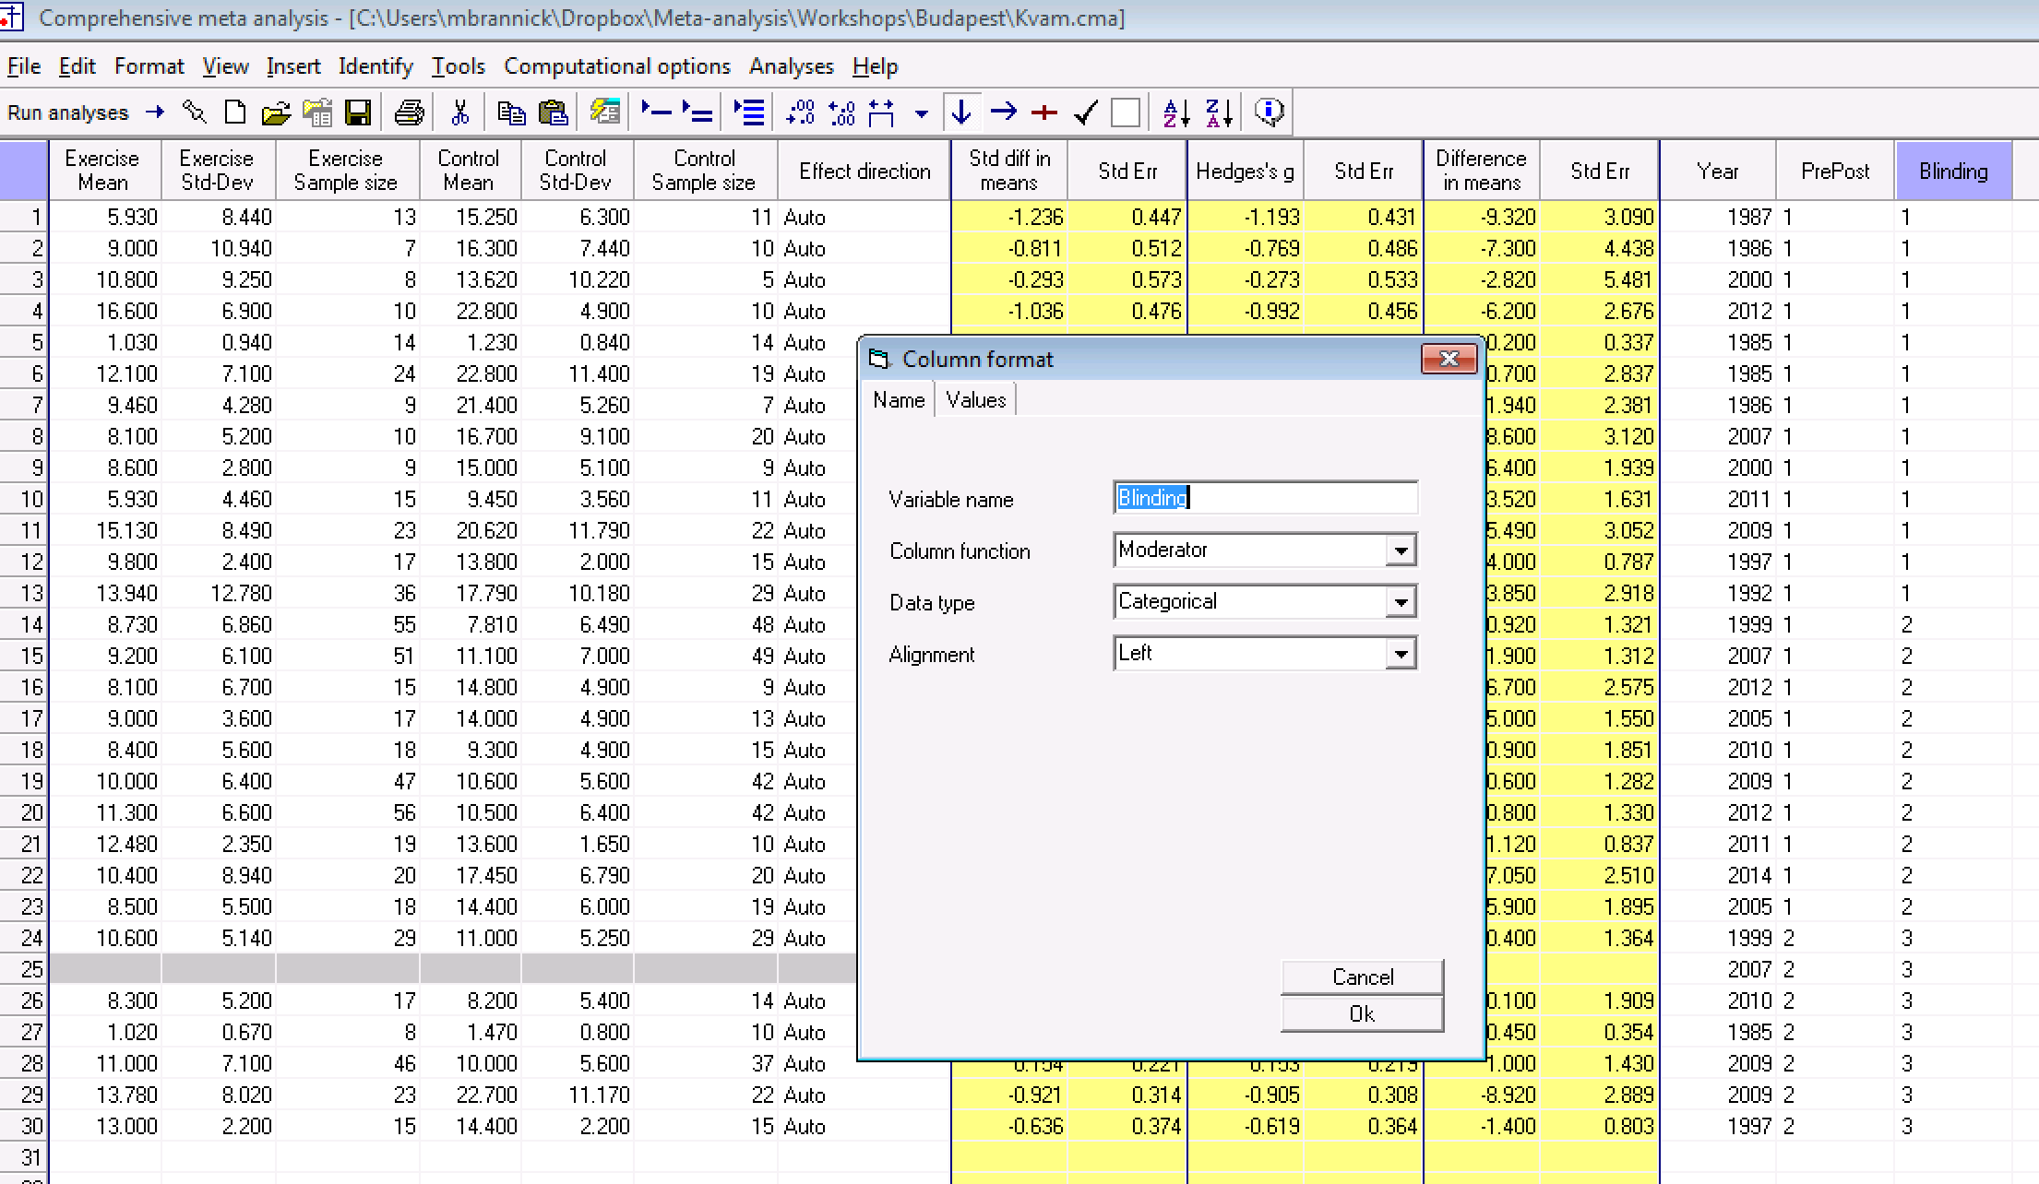
Kvam data
Moderator – blinding of outcome judges to condition
To test for a moderator, you need a column designated as a moderator.

Slide 11
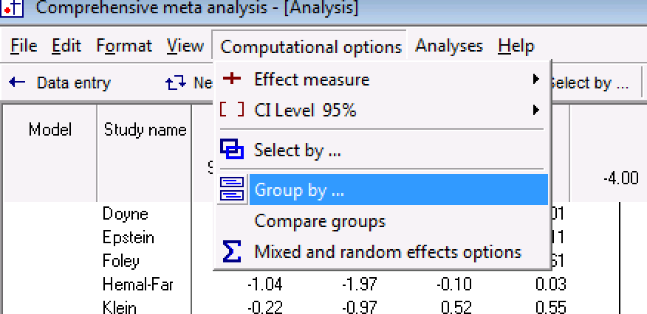
Moderator analysis
Select the two blinding levels. Level 3 is for post outcomes and indicates ‘missing’ for this analysis.

Slide 12
After selecting data, choose computational options, and group by Blinding. Then also choose the pooled and compare options in the box that appears (not shown here).

Slide 13
From here, you can go to the next table for the test of the difference, or you can go to high resolution plot.

Slide 14
Mixed means moderator is fixed, effect size is random (the typical case).
Group means
Test of the significance of the moderator (null hypothesis of no difference in means between groups). This is a significant difference (consistent with the publication).

Slide 15
Moderator (categorical)
Research question or Study aims
Search & eligibility
Coding, computation of effects, conversions
Analysis
Overall
Graphs
Moderators
Sensitivity
Discussion
They noted a significant difference between subgroups. No blinding -> bigger effect.

Slide 16
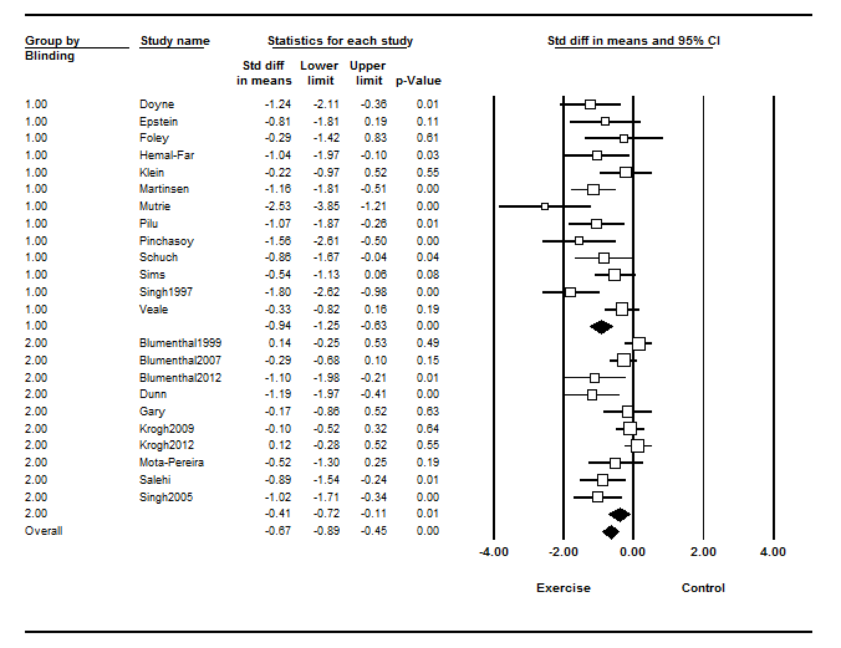
My output.

Slide 17
Weighted Regression for Continuous Moderator
OLS regression
Assume equal error variances (homoscedasticity)
Estimate magnitude of error, minimize SSE
Weighted regression
Error variances assumed known
Error variances are unequal
In meta-analysis, we know the sampling (error) variances, so can use weighted regression
Minimize weighted SSE

Slide 18
Hypothetical SAT-Q and pct quant courses in GPA
Study | r | z | N | w | Pct Q
1 | .40 | .42 | 200 | 197 | .10
2 | .42 | .45 | 175 | 172 | .15
3 | .45 | .48 | 250 | 247 | .12
4 | .60 | .69 | 250 | 247 | .20
5 | .55 | .62 | 200 | 197 | .25
6 | .65 | .78 | 225 | 223 | .30
Does the percentage of quantitative courses influence (moderate) the size of the correlation between SAT-Q and GPA?

Slide 19
SAT-Q Matrices (1)
V
X |  | y
1 | .10 | .42
1 | .15 | .45
1 | .12 | .48
1 | .20 | .69
1 | .25 | .62
1 | .30 | .78
.005 | 0 | 0 | 0 | 0 | 0
0 | .006 | 0 | 0 | 0 | 0
0 | 0 | .004 | 0 | 0 | 0
0 | 0 | 0 | .004 | 0 | 0
0 | 0 | 0 | 0 | .005 | 0
0 | 0 | 0 | 0 | 0 | .005
1 | 1 | 1 | 1 | 1 | 1
.10 | .15 | .12 | .20 | .25 | .30
X’

Slide 20
SAT-Q Matrices (2)
197 | 0 | 0 | 0 | 0 | 0
0 | 172 | 0 | 0 | 0 | 0
0 | 0 | 247 | 0 | 0 | 0
0 | 0 | 0 | 247 | 0 | 0
0 | 0 | 0 | 0 | 197 | 0
0 | 0 | 0 | 0 | 0 | 222
.27
1.67
Intercept
Slope
.0062 | -.0289
-.0289 | .1540
V⁻¹

Slide 21
SAT-Q (3)
.0062 | -.0289
-.0289 | .1540
Intercept
.27
1.67
Slope
S. E.
.0787
.3924
Intercept
S.E. = sqrt(c_{jj})
Slope
t
3.41
4.25
Intercept
t (or z) = b/S.E.
Slope

Slide 22
Kvam - Continuous Moderator
CMA has improved the regression model substantially
Scatterplot
Multiple moderators
Statistical Tests & Diagnostics

Slide 23
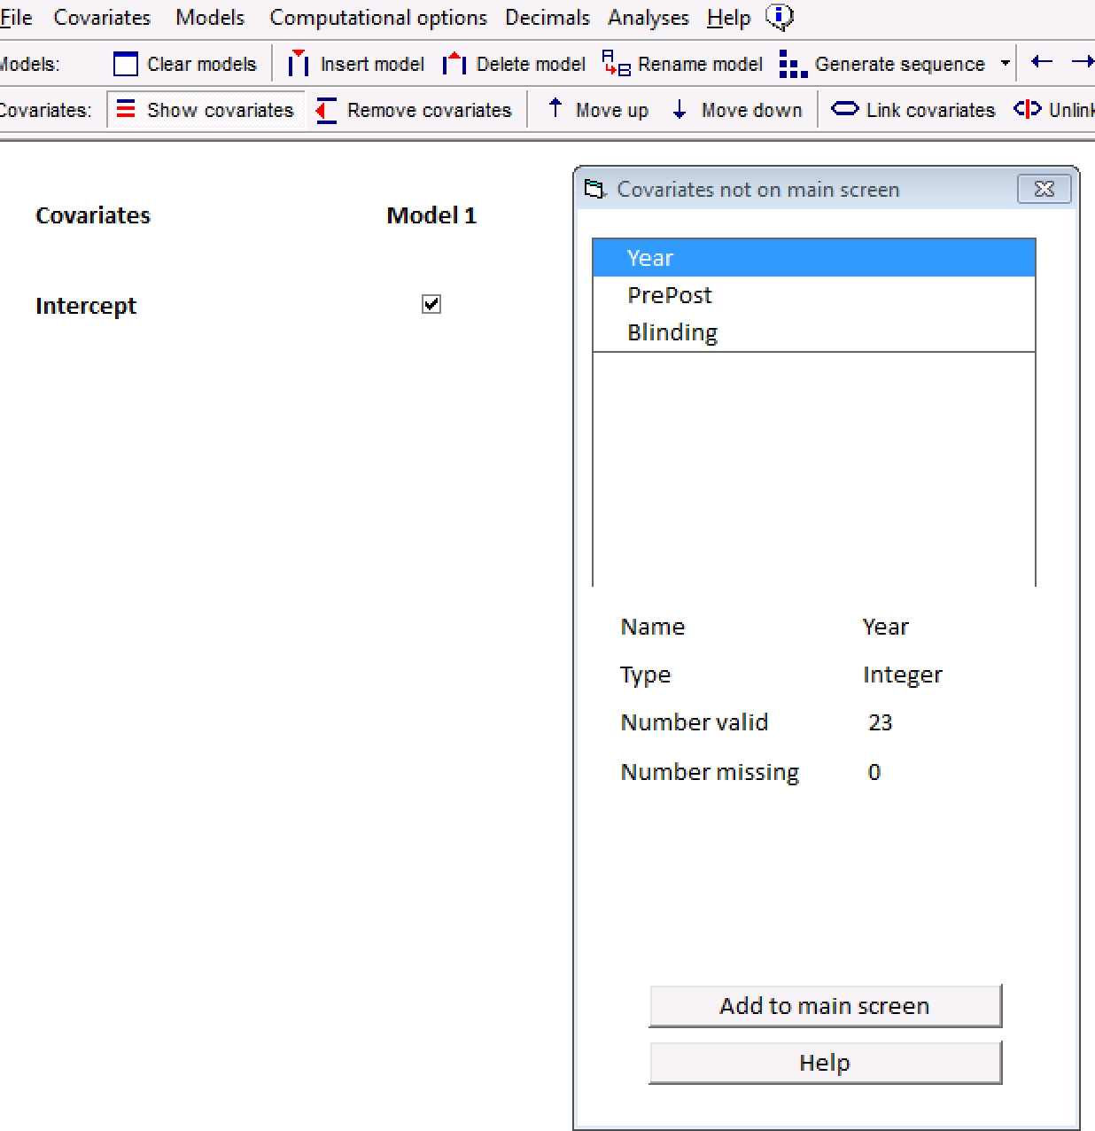
Regression
2
3
Select the data you want
Analyses -> Meta regression 2
Add variable(s) you want

Slide 24
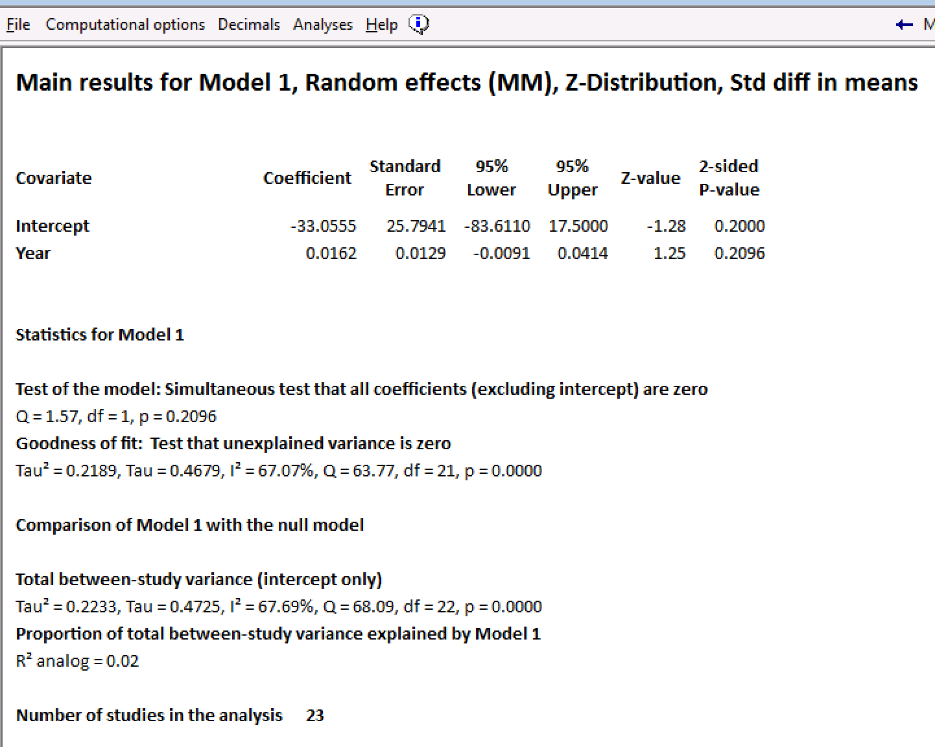
Output
Moderator
Regression equation
Method of computation & testing

Slide 26
Incremental variance

Slide 27
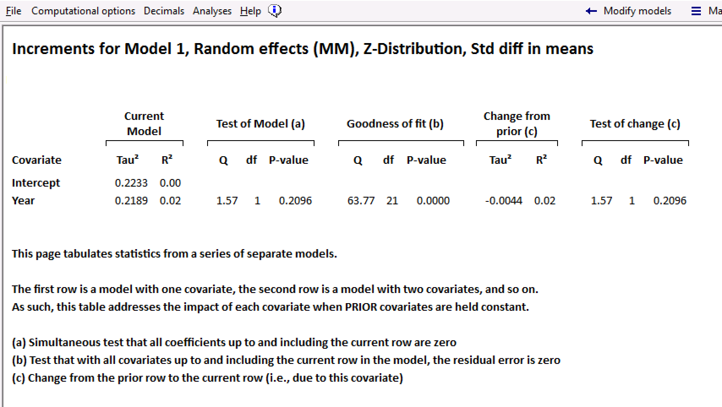
Hierarchical tests

Slide 28
Regression Diagnostics

Slide 29
CMA Exercise 5
Run the moderator test for the ’blinded’ moderator and interpret
Run a forest plot for the same moderator
Run a moderator test for the year of publication
Run a regression plot for the same moderator

Slide 30
Break
Coming up next ->
Research question or Study aims
Search & eligibility
Coding, computation of effects, conversions
Analysis
Overall
Graphs
Moderators
Sensitivity
Discussion

Slide 31
Sensitivity
Publication bias
Trim-and-fill
Failsafe N (avoid this)
With multiple-arm studies, chose the arm with the largest effect (failed to ask ‘what if?’)
Did not report any adjustment for outliers or differences in coder judgment
In general, you are trying to see if your results would change if you made different decisions. If no difference, more confidence in conclusions.
Research question or Study aims
Search & eligibility
Coding, computation of effects, conversions
Analysis
Overall
Graphs
Moderators
Sensitivity
Discussion

Slide 32
CMA Exercise 6
Drop the largest and smallest effect sizes (one of each) from the overall pretest dataset (23 to 21 effect sizes)
Rerun the overall analysis
Interpret the mean, CI, I-squared, and PI
Compare to values you obtained using all 23 effect sizes (what differences and why)

Slide 33
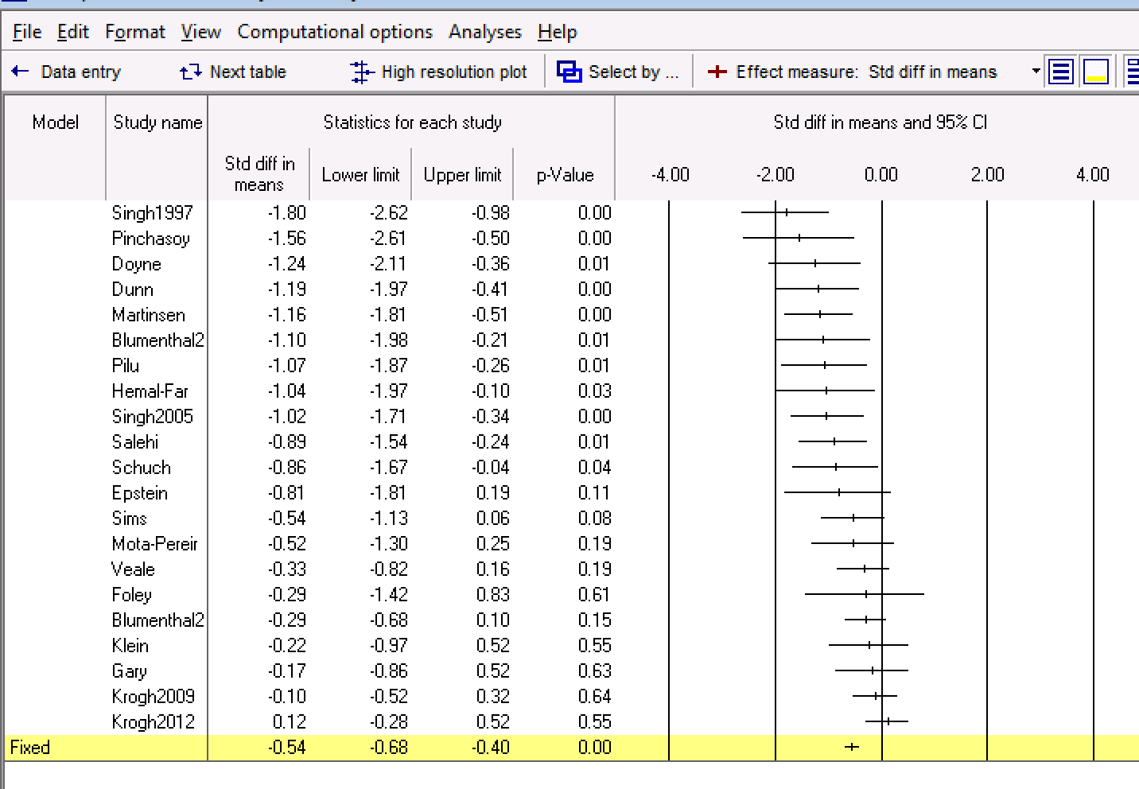

Slide 35
Kvam’s Discussion
Paragraph saying what is new and different
Overall, exercise effective
Difference between blinded and not
Publication bias analyses suggest overall difference smaller, but still there
Difference for control but not for conventional treatment (CBT etc.)
Effects of exercise diminish after treatment ends
Need effectiveness studies, and studies of patient adherence
Research question or Study aims
Search & eligibility
Coding, computation of effects, conversions
Analysis
Overall
Graphs
Moderators
Sensitivity
Discussion

Slide 36
Critique of Kvam
Nice job with:
Flow chart
Search terms & data in appendix
Random-effects model
Graphs
Publication bias and study quality (blinding) assessments
Logical next steps and where studies are needed
Could have improved by:
Prediction intervals and REVC
Graph of pre and post means for follow up
Rater (coder) reliability: pct agree, kappa, ICC
Multiple arms – chose largest - sensitivity

Slide 37
Break
Coming up next
Practice with a second dataset

Slide 38
Choose your data
McLeod (2007) – Association between parenting and childhood depression
Effect size = r
K = 45
Continuous and categorical moderators
Fleminger (2003) – Association between head injury and Alzheimer’s disease
Effect size = OR
K = 15
Continuous and categorical moderators

Slide 39
Analysis
1 Compute and interpret overall mean, CI
2. Compute and interpret heterogeneity stats
Tau-squared
I-squared
PI
3. Graph overall results with forest plot and interpret

Slide 40
Analysis 2
4. Compute and interpret categorical moderator
5. Compute and interpret continuous moderator
6. Run a funnel plot with trim-and-fill and interpret
7. Compare your results to those of the published article

