Slide 1
Hunter & Schmidt in Metafor

Slide 2
Input

Slide 3
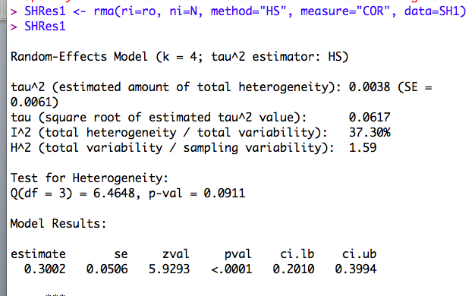
Bare-bones - metafor

Slide 4
Correct for ryy
The estimated remaining REVC is zero. Thus the prediction or credibility interval and the confidence interval would be the same. There are a couple of ways to proceed – using the equation or using theory.

Slide 5
Correct for ryy
Take original mean, SE(Mean) and tau. Divide by Mean(ryy) This your new value of the mean, and use the SE(Mean) and SE(PI) =sqrt[V(M)+adj(Tau-sq)] to compute new CI and and new PI. The width of the intervals is only approximate, but it should be close.
For more corrections (e.g., rxx as well as rxx), use the additional variables as moderators. The divide the mean, SE(Mean) and residual SE(PI) by the compound attenuation factor.

Slide 6
Comparison
H & S | ES mean | SE(M) | Tau | CI Lo | CI Hi | CR Lo | CR Hi
BB | .29 | .05 | .06 | .19 | .38 | .17 | .40
ryy = .85 | .32 | .10 | .05 | .20 | .43 | .22 | .41
Metafor
BB | .30 | .05 | 06 | .20 | .40 | .14 | .46
ryy =.85 | .33 | .05 | .00 | .22 | .43 | .22 | .43
Same data (4 studies). The main difference is the wider PI for the Metafor analysis with no correction (compared to the H&S bare-bones. The reason is that the Hunter & Schmidt credibility interval leaves out the error associated with the estimation of the mean. I did not use H&S formulas for corrected CI (I divided the bare-bones SE(M) by .85, the average ryy.

Slide 7
LMX_AC data
Bare-bones analog in metafor, all 92 studies.

Slide 8
LMX corrected for ryy
Even though the model (and thus ryy) is not significant, I am going to use the new (adjusted) value of tau along with the average ryy to figure my analog to the H&S calculations with the meta-analysis correcting for reliability in the criterion only.

Slide 9
Conventional analysis in z

Slide 10
Conventional analysis in r

Slide 11
Generic model input z

Slide 12
LMX_AC Results Compared
Model | Mean | CI Lo | CI Hi | CR Lo | CR Hi
Bare bones
HS | .43 | .41 | .45 | .24 | .61
M COR HS | .43 | .41 | .46 | .23 | .63
ZCOR | .46 | .44 | .49 | .23 | .70
Z back to r | .43 | .41 | .46 | .22 | .62
Adjust ryy
HS | .45 | .43 | .48 | .25 | .65
Met COR HS | .46 | .43 | .48 | .25 | .67

