Slide 1
Methods Research

Slide 2
Bonett 1
29. Bonett DG: Meta-analytic interval estimation for Pearson correlations. Psychological Methods 2008, 13:173-189.
Psych Methods is a very high prestige journal
Bonett argues
Common effects models don’t work well in practice because coefficients vary in real studies
Random effects model handle varying coefficients, but have the unmet assumption of being random sample from a population, so they don’t work well
Proposed: New fixed, effects, varying coefficients model

Slide 3
Bonett 2
“unless the m study populations are randomly sampled from a specific superpopulation, the researcher cannot make a statistical inference…” (p. 173)
The collection of studies in a meta is pretty much NEVER going to be a random sample from a well-defined population.
He proposes:
But this is just the ordinary unit weighted average (add them and divide by how many you have, no weights). His reasoning is that you want to estimate the average of the distribution, not the weighted average of the distribution. Weights make sense if all the studies estimate the same identical parameter.

Slide 4
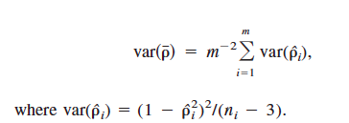
Bonett 3
He proposes a confidence interval that will contain the mean of the varying coefficients.
This says, take the average of the study variances and divide by m (number of studies) to get the variance of the mean. He does one other thing because the sampling distribution of the mean is non-normal (remember the Fisher r to z transformation).

Slide 5
Bonett 4
To make it Normal, and
To find the confidence interval and bring it back to r from z. But conceptually, all he does is
Find the unit weighted mean
Find the average sampling variance and divide by the number of studies
Go up and down 2 standard errors for the CI.

Slide 6
Bonett 5
Then he runs a computer simulation to show that his method works quite well in the sense that the CI contains the parameter about 95 percent of the time with a decent CI width.
And that it works better than the competition, which doesn’t always make 95 percent.
But people don’t seem to be following his advice and using these calculations. Why do you think that is?

Slide 7
Bonett 6
Bonnet does not estimate tau-squared. What if you want to know that? (Usually you do IMHO.)
The random-effects inference is usually what we want. We want to know the mean of a population bigger than what we have at hand, even if what we have at hand is not a random sample.
Bonett assumes each correlation is a random sample from its own population. By his reasoning, no inference is possible from our typical nonrandom samples.

Slide 8
Johnson 1
30. Johnson BT, Low RE, MacDonald HV: Panning for the gold in health research: Incorporating studies' methodological quality in meta-analysis. Psychology & Health 2015, 30(1):135-152.
Surveys 200 meta-analyses regarding how they measure methodological quality
Argues that quality scales can be entered as variables in the analysis and may show interaction with theoretical variables.

Slide 9
Johnson 2
Reviewed 3 domains
Behavioral interventions to reduce risk of HIV
Exercise for mental health
Exercise for blood pressure

Slide 10
Johnson 3
Meta-analysis is increasing in these areas. Methodological Quality measures appear to be used, and best evidence synthesis (design quality exclusion criteria applied, e.g., RCT) is increasingly popular. These are all health related, tho.

Slide 11
Johnson 4
Advocates for MQ scale interaction
Found that motivation training was more effective for condom use in high quality studies.
Found dose-response for exercise and depression in cancer survivors as a function of study quality (more exercise, more effect, but only in higher quality studies).
They say you can use entire scale, single items (e.g., RCT) or clusters of related items for analysis.

Slide 12
Johnson 5

Slide 13
Johnson 6

Slide 14
Johnson 7
Argues that studies that do not meet the ‘gold standard’ may still offer important information.
Quantifying methodological quality is a way to see if there is a relation between ES and design

Slide 15
Schild 1
31. Schild AHE, Voracek M: Finding your way out of the forest without a trail of bread crumbs: development and evaluation of two novel displays of forest plots. Research Synthesis Methods 2014.
Decided to do research on the forest plot. What do we do with it? Can it be improved?
3 probs in conventional forest plot
Tails for small studies too visible
Point estimate concealed in box
Distribution should be thicker in the middle (Normal)

Slide 16
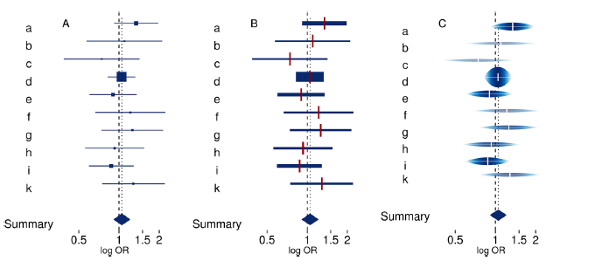
Shild 2
Conventional forest plot
Thick plot
Rainforest plot

Slide 17
Shild 3
They set up an experiment, asking meta-analysts to interpret plots. Had them estimate I-squared from the plot, find the highest weighted study, determine if the overall effect is significant, etc. Counted up correct answers.
Found rainforest plots resulted in most accurate inferences (higher number of questions answered correctly), then thick plots, then conventional plots.

