Slide 1
Excel Simple Computation

Slide 2
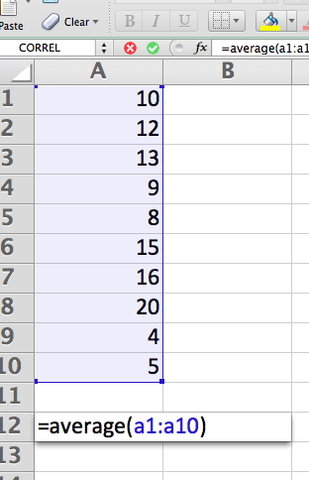
Compute the Mean
Place the cursor over a cell, click, and type. Pressing the enter key moves to the next cell. Here I typed in 10 numbers (10,12,13,…5).
To find the mean, type the function into a cell

Slide 3
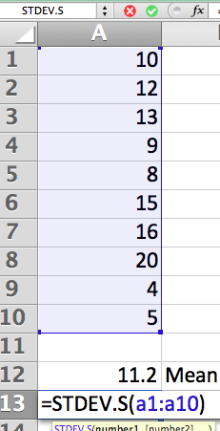
Compute the Standard Deviation
Stdev.s is the sample estimate of the population standard deviation. It uses (n-1) in the denominator.

Slide 4
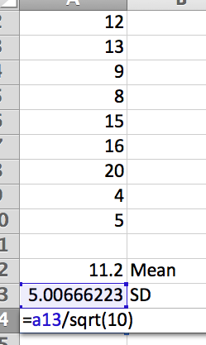
Compute Standard Error of the Mean
To find the standard error of the mean, divide the standard deviation by the square root of the sample size.

Slide 5
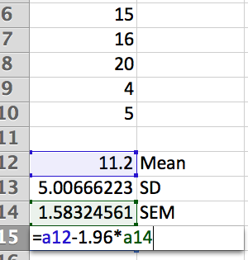
Compute the 95 percent confidence interval for the mean (LB)
To compute the lower bound, subtract 1.96 times the standard error from the mean.

Slide 6
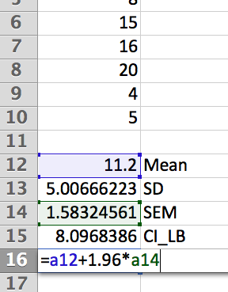
Compute the 95 percent confidence interval for the mean (UB)
To compute the upper bound, add 1.96 times the standard error to the mean.

Slide 7
Arithmetic and Functions
Arithmetic
Functions
For addition and subtraction, just put a plus or minus and either a number or a reference to a cell in the worksheet. Multiplication is * and division is /. Computers operate on numbers by default in a specific order, so use parentheses to be sure that operations happen in the order you want.
You can insert functions through the insert command on the menu bar or you may have a function key in your version of Excel. You may input numbers, specific cells, or ranges of cells into the functions. Here I used the mean, SD, and square root functions, but there are many more.

