Slide 1
Heterogeneity in Hedges

Slide 2
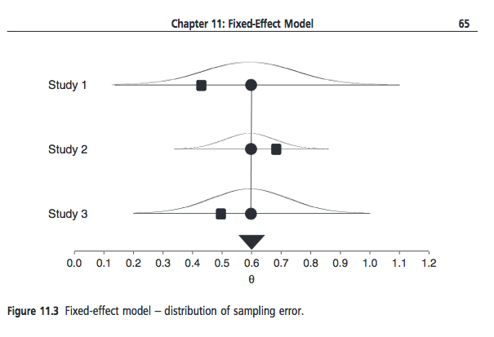
Fixed Effects
Borenstein et al., 2009, pp. 64-65

Slide 3
Random Effects
Borenstein et al., 2009, p. 72.

Slide 4
Typical Model
In most applications of meta-analysis, we want to infer things about a class of studies, only some of which we are able to observe. The inference we typically want is random-effects.
In most meta-analyses, there is a good deal of variability after accounting for sampling error. The model we typically want is varying coefficients (a model that computes the REVC).
There are always exceptions to rules, but this is the default position.

Slide 5
Homogeneity Test
When the null (homogeneous rho) is true, Q is distributed as chi-square with (k-1) df, where k is the number of studies. This is a test of whether Random Effects Variance Component is zero.

Slide 6
Q
Recall the chi-square is the sum of z-square (sum of deviates from the unit normal, squared.

Slide 7
Estimating the REVC
If REVC estimate is less than zero, set to zero.

Slide 8
Random-Effects Weights
Inverse variance weights give weight to each study depending on the uncertainty for the true value of that study. For fixed-effects, there is only sampling error. For random-effects, there is also uncertainty about where in the distribution the study came from, so 2 sources of error. The InV weight is, therefore:

Slide 9
I-squared
Conceptually, I-squared is the proportion of total variation due to ‘true’ differences between studies. Proportion due to random effects.

Slide 10
Comparison
 | Depnds on k | Depends on Scale
Q | X
P | X
T-squared |  | X
T |  | X
I-squared
I-squared does depend on the sample size of the included studies. The random-effects variance has some size, which is indexed in units of the observed effect size (e.g., r). The larger the sample size, the smaller the sampling variance, and thus the larger I-squared. To me, the prediction interval is the most interpretable.

Slide 11
Confidence intervals for tau and tau-squared
Insert ugly formulas here – or not.
Suffice it to say that confidence intervals can be computed for the random-effects variance estimates.
In metafor, compute the results of the meta-analysis using rma. Then ask for the confidence interval for the results.

Slide 12
Prediction or Credibility Intervals - Higgins
Makes sense if random effects.
M is the random effects mean (summary effect).
The value of t is from the t table with your alpha and df equal to (k-2) where k is the number of independent effect sizes (studies). The variance is the squared standard error of the RE summary effect.
This is the prediction interval given in Borenstein et al. 2009

Slide 13
Prediction or Credibility Intervals - Metafor
Metafor uses z rather than t. To get the prediction interval for the mean in metafor, ask for ‘predict’ on the results. If you want the Higgins version (which you probably do unless you have k>100 studies), you will need to use Excel or some calculator to replace the critical value of z with t.

Slide 14
Two Examples
Example in d
Example in r (transformed to z)
Then the Class Exercise

Slide 15
Example 1 (Borenstein)
Data from Borenstein et al., 209, p. 88

Slide 16
Run metafor
Note tau and the standard error of the mean. You will need these for computing the Higgins prediction interval.

Slide 17
Find Confidence Intervals

Slide 18
Find the metafor Pred. Int.
Note the difference between the confidence interval and the prediction interval (credibility interval). A large REVC makes a big difference. I prefer the prediction interval for interpretation of the magnitude of variability because it is expressed in the range of outcomes you expect to see in the metric of the observed effect sizes. In this case, it would be reasonable, based on the evidence, to see true standardized mean differences from about -0.07 to .79. This is more interpretable than I-squared = 54 percent. However, note that the CI for tau-squared is large, so take this interval with a grain of salt.

Slide 19
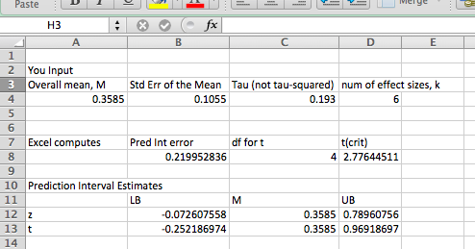
Compute Higgins Pred. Int.
Note that metafor is using z, not t, in computing the prediction interval. If you want to use Higgins methods, compute in Excel from estimates provided in metafor. See my spreadsheet

Slide 20
Example 2
McLeod 2007
Correlation between parenting style and child depression

Slide 21
Run metafor
Note I could have input z and v from the Excel file…

Slide 22
Prediction Interval
Because we analyzed in z, we need to translate back to r. Also we don’t have Higgins’ prediction interval. So let’s compute.

Slide 23
Translate back r from z

Slide 24
Class Exercise
Use the McDaniel data (dat.mcdaniel1994 ) to compute I-squared and the prediction interval (both z and t-based) for these data. Compute using ZCOR and translate prediction intervals back into R.
If the effect sizes are correlations between job interview scores and job performance criteria, what is your interpretation of the result?
Interpretation of the overall mean
Interpretation of the amount of variablility
Interpretation of the prediction interval

