Slide 1
Meta-Analysis Graphs

Slide 2
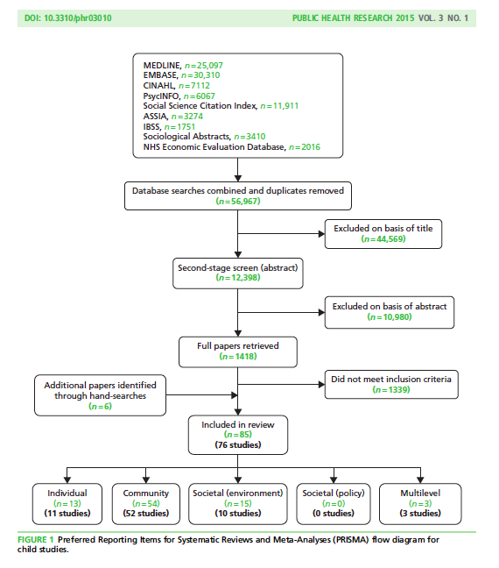
Flow Diagram
These authors used PRISMA as a guide for their chart, but they are medical. Whatever you do should communicate to your audience so that the study can be replicated.
Bambra CL, Hillier FC, Cairns J-M, Kasim A, Moore HJ, Summerbell CD. How effective are
interventions at reducing socioeconomic inequalities in obesity among children and adults?
Two systematic reviews. Public Health Res, 2015;3(1).

Slide 3
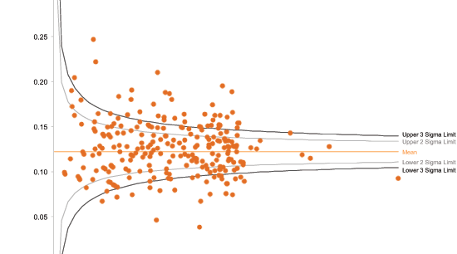
Funnel Plots
Shows ES by precision. Expect a funnel shape if fixed-effects sampling distribution. Asymmetry suggests pub bias; excess variance suggests heterogeneity (moderators). This one shows pretty good symmetry but lots of variability (mortality rates by hospital).

Slide 4
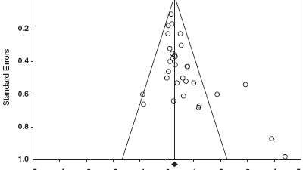
Funnel Plot
This one suggests publication bias (small studies with large ES).
I think this graph was created using Comprehensive Meta-Analysis (CMA), which is stand-alone software).

Slide 5
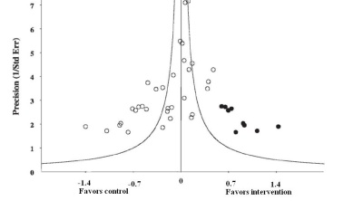
Funnel Plot
This one shows imputed data: ‘trim and fill’ on the basis of symmetry.

Slide 6
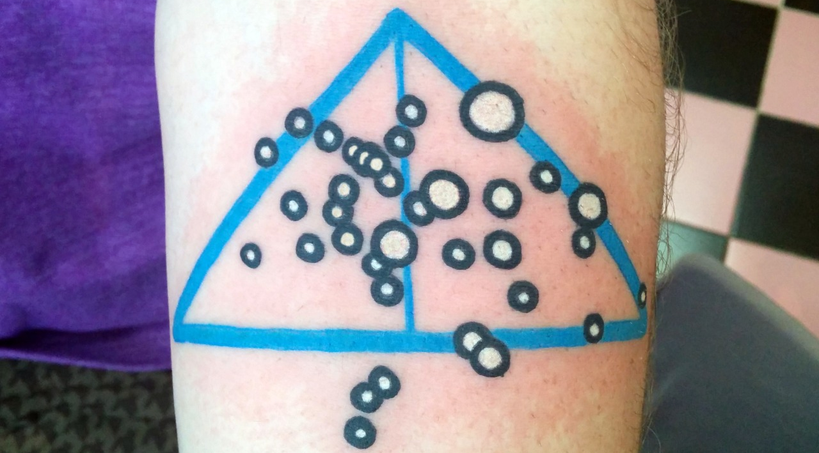
Funnel Plot
Epi_Meta_Plots
This one shows a masochist.

Slide 7
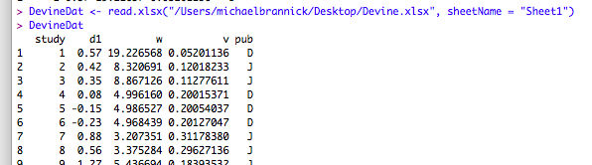
Input to R & Check Data

Slide 8
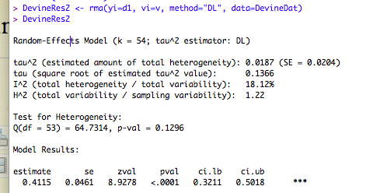
Compute Summary

Slide 9
Compute Funnel

Slide 10
R Funnel Plot
This plot shows a lot of heterogeneity. It also shows asymmetry consistent with missing nonsignificant results (perhaps publication bias). But the mean is too high to worry about publication bias as the sole explanation.
LMX & Affective Commitment
I added the brown line to mark the approximate place of a nonsignificant correlation

Slide 11
Class Exercise
Open R, metafor
Download GenderMath.xlsx from website and import
  Difference between boys and girls in math achievement (positive d means boys’ mean is higher)
  Multiple countries and multiple moderators
Compute a meta-analysis overall effect size (d1 is standardized mean difference, v is variance of SMD)
Create a funnel plot

Slide 12
Forest Plots
General Types
  General - unsorted
  Sorted
  Moderators - subgroups
  Cumumlative

Slide 13
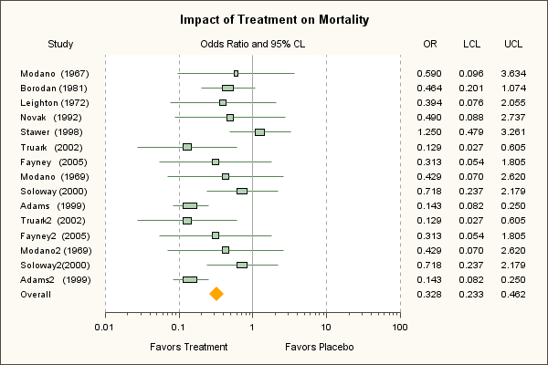
Forest Plots 1 – General Summary
Note box, wings, and diamond.
This plot was made with SAS. You can do this with enough patience; I use various programs.

Slide 14
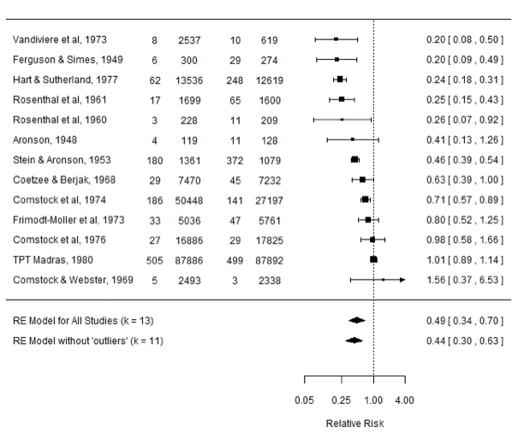
Forest Plot 2 – Sort by ES
I think this graph was created using the program metafor in R.
Steady progression? Missing middle? Expect some curl at the ends for small samples.
Source: http://stats.stackexchange.com/questions/107557/forest-plot-for-meta-analysis-displaying-the-mean-es-with-and-without-outliers

Slide 15
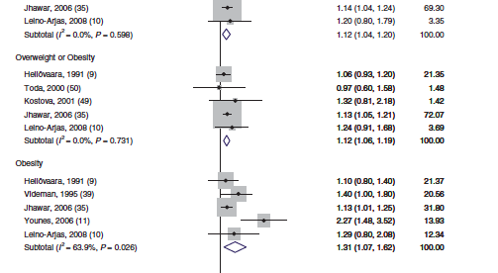
Forest Plot 3 – Subgroups
Subgroup means and CIs
I think this graph was created using the program meta in R.
Shiri (2014) Obesity & Sciatica

Slide 16
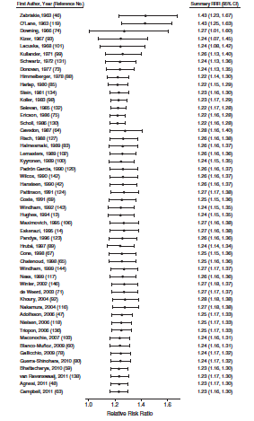
Forest Plot 4 - Cumulative
Pineles (2014). Miscarriage and exposure to tobacco smoke.
Shows that contrary to some authors, there has always been good evidence of risk.
Overall OR and CI plotted by adding each study over time.
Note on sociology of science; often largest ES first; decline over time.

Slide 17


Forest Plots in R
This is the default. There are too many studies for this to look good. I would start by sorting by the moderator and then by the effect size.

Slide 18
Sorting in R
You can always sort in Excel or some other program if you’d rather
The sort command you want in R is ‘order’
Let’s look at an example:
The Devine data shows standardized mean differences for something… and it’s coded by journal article or dissertation.

Slide 19
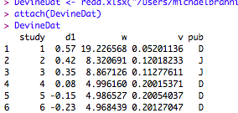
Attach the data
You have to ATTACH the data (object) and have this accepted without error before you can sort.

Slide 20
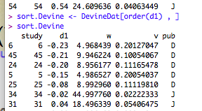
Sort the Data by ES

Slide 21
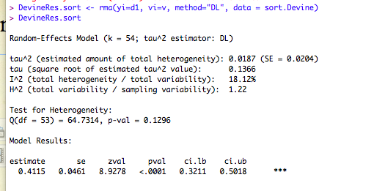
Rerun the Analysis

Slide 22
Compute Sorted Forest

Slide 23
Sort by Publication and ES

Slide 24
Categorical Moderator

Slide 25
Input File
z | w | V | Sex
0.42 | 197 | 0.005076142 | 1
0.45 | 172 | 0.005813953 | 1
0.48 | 247 | 0.004048583 | 1
0.69 | 247 | 0.004048583 | 2
0.62 | 197 | 0.005076142 | 2
0.78 | 223 | 0.004484305 | 2

Slide 26

SAT & GPA
Overall model, no moderator

Slide 27
Add Moderator
A bit hard to see in this graph, but the grey diamonds align vertically. With more ES sorted by ES value, the grey diamonds do a good job of showing the overall category mean.
The program represents the group means by a grey diamond that is superimposed on each study.

Slide 28
Add Other Stuff
You can add lots of information into the graph to enhance the graph’s ability to communicate to your audience.
  Labels
  Vertical lines
  Diamonds
  Change Axes – limits or scale
See the file “forest_plot_modification.R”

Slide 29
Continuous Moderator

Slide 30
Input Data
z | w | v | PctQ
0.42 | 197 | 0.005076142 | 0.1
0.45 | 172 | 0.005813953 | 0.15
0.48 | 247 | 0.004048583 | 0.12
0.69 | 247 | 0.004048583 | 0.2
0.62 | 197 | 0.005076142 | 0.25
0.78 | 223 | 0.004484305 | 0.3

Slide 31
Forest with Continuous Prediction
This is probably not the best way to show the results. A meta-analytic scatterplot (meta-regression) with best fit line would be better. But it does give a sense of the data.

Slide 32
Heterogeneity
Effect sizes often vary far more than what would be expected by sampling error
  Report REVC and CI
Some of this variability can be accounted for by moderators explicitly incorporated into the model
  Report reduction and remaining heterogeneity
The remaining heterogeneity is a problem.
  Meaning of the average
  Unanswered question of source
  Representing the heterogeneous effects

Slide 33
Prediction Interval
Interval contains both sampling variance and random-effects variance
Intended to contain a percentage (usually 95) of the infinite-sample effect sizes
If REVC is large, the prediction interval is much larger than the confidence interval

Slide 34
Meta-analysis of 71
Samples (studies) comparing classroom instruction versus online instruction on tests of declarative knowledge (college classes and corporate training).
Diamond is the Confidence Interval, the red line at bottom is the Prediction Interval; it shows expected outcomes. Average difference near zero, but SUBSTANTIAL variability. Begs us to ask why the study outcomes are so different.
Favors
classroom
Favors
web
Red is random effects.
Orange is fixed effects.

Slide 35
Sitzmann data
Sorted by ES
Classroom
Web

Slide 36
Meta-analysis of 12 studies of procedural knowledge; college students and corporate training. Note that many studies are significantly different from zero, but on opposite sides. Expected effects range approximately from -1.25 to 1.25.
Favors Classroom
Favors Web
This graph was produced using the software program MIX (stand-alone software).

Slide 37
Meta-analysis of 63 interventions comparing instruction through the web vs. other (mostly classroom) instruction on tests of declarative knowledge in health professionals.
Note that again there is a slight overall mean difference favoring the internet, but even larger variability (see the horizontal red line). The expected true differences range from about .7 in favor of the classroom to about 1.0 in favor of the internet.

Slide 38
Results for 12 studies of health professionals for procedural knowledge. Note same pattern of results; enormous variability.
Most studies show results significantly different from zero, but they fall on both sides of the argument.
Favors Alternate
Favors Web
Cook, Levinson, Garside, Dupras, Erwin, & Montori (2008). Internet-based learning in the health professions. Journal of the American Medical Association, 300, 1181-1196.

Slide 39
Shrunken Estimates
Bayesian estimates of local populations (estimates of the location of infinite-sample effect sizes) aka Empirical Bayes Estimates
Moves observed effect sizes toward the mean in proportion to uncertainty
  Smaller movement if study sample sizes are large
  Smaller movement if tau-squared is large
  Moves studies to the mean if sample sizes are small or if tau-squared approaches zero
This kind of analysis is more difficult to do correctly; I do not expect you to do it for this class, but want you to know that it is available and might be useful.

Slide 40
EB Estimates: Conceptual Diagram
This slide copied from a talk by David Rindskopf

Slide 41
Forest Plot – 2 Methods Stacked for Comparison
Bayes
Why is this study different?
Rodriguez
Bayesian Estimate
Rodriguez & Maeda estimate
This graph was produced using MS Excel and PowerPoint.
Prediction Interval
Mean and 95 % CI

Slide 42
Shrunken Estimates in R
The metafor package uses the function BLUP( ) to produce ‘shrunken’ or empirical Bayes estimates for individual studies.

Slide 43
Class Exercise
Recall GenderMath
Create a forest plot (unsorted data)
Sort the data by G1 then d1
Compute a model with G1 as a moderator
Create a forest plot with data ordered by G1 and d1

