Slide 1
Lab 1 Introductions to R
Sean Potter

Slide 2
Today’s Agenda:
Lab Overview
Intro to R
Importing data to R
Creating simple graphs using R
Assignment & Questions

Slide 3
Overall Lab Purpose
Provide hands-on instruction and practice with the analyses and techniques learned in lecture.
Develop template codes for you to use in the future.

Slide 4
Assignments
Homework will be R data analysis activities and some computational problems (including some problems from Howell)
Due at the beginning of the next class
Many assignments will require the turning in of syntax and/or output. These will be specifically requested and be uploaded to the assignment folder in Canvas
Start early so any questions or issues can be addressed before due date!

Slide 5
Introduction to R

Slide 6
What is R?
Programming language (like C#, Python, Java, etc.)
Similar to using SAS, SPSS syntax
Open-source (don’t have to pay $$$ license fees!)
Increasingly popular in academia, industry
Updated functions constantly being provided
Easily produces customizable, journal-quality graphics
Why R?

Slide 7
What is RStudio?
IDE (Integrated Development Environment)
User-friendly interface when using R
Also open source

Slide 8
Installing R on Own Computer
Install R
Open an internet browser and go to www.r-project.org.
Click the "download R" link in the middle of the page under "Getting Started."
Select a CRAN location (a mirror site) and click the corresponding link.
Click on the "Download R for (Mac) OS X" link at the top of the page.
Click on the file containing the latest version of R under "Files."
Save the .pkg file, double-click it to open, and follow the installation instructions.
Install R Studio
Go to www.rstudio.com and click on the "Download RStudio" button.
Click on "Download RStudio Desktop."
Click on the version recommended for your system, or the latest Mac version, save the .dmg file on your computer, double-click it to open, and then drag and drop it to your applications folder.

Slide 9
First Taste of R
We’ll do a overview of R, and then review it again next week
Follow along
Later play with R following the slides on your own
Go to “Start,” then “All programs,” then “RStudio”

Slide 10
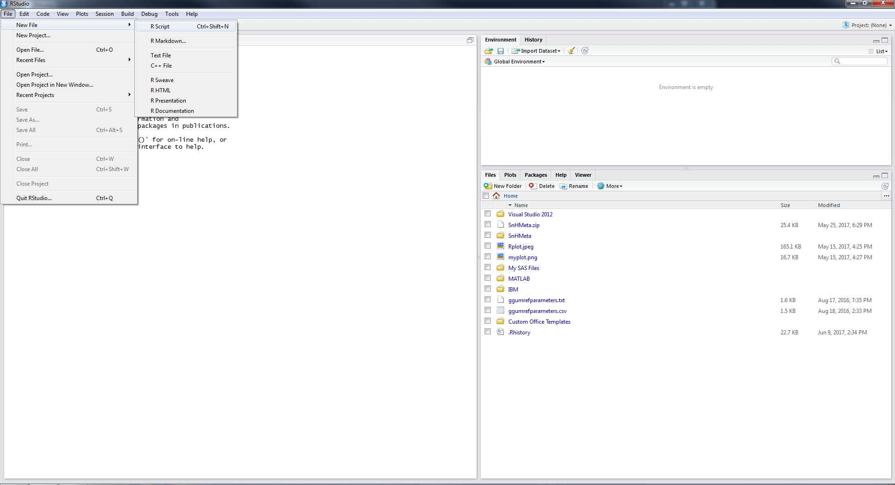
Starting Out
Select new R Script

Slide 11
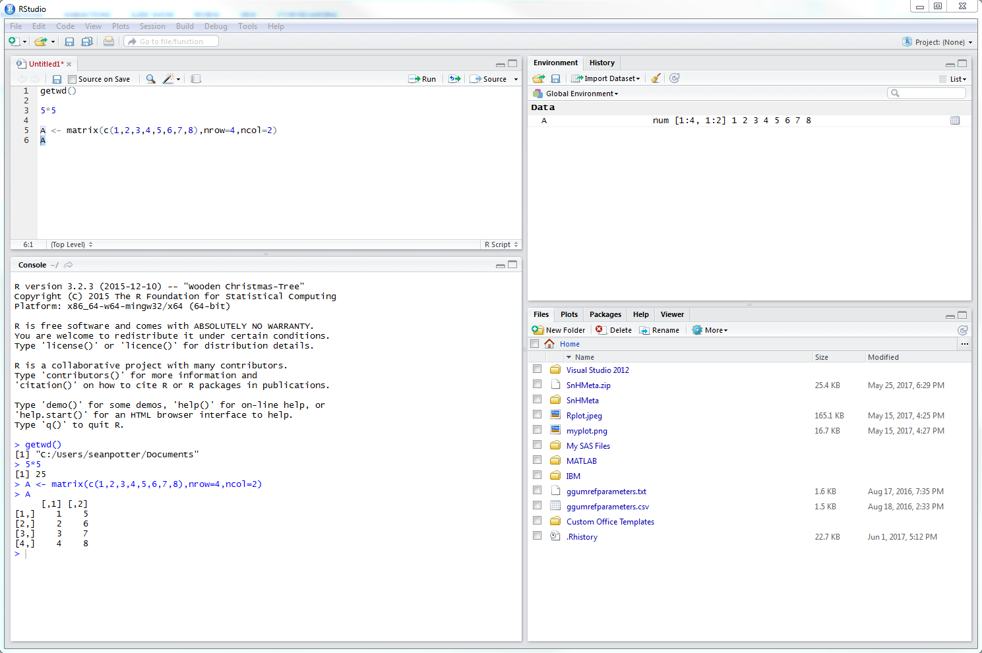
Run whole Script or highlighted section
The editor is where you can write R code that can be saved and reran.
Press CTRL + Enter to run highlighted code
Environment tab shows all active objects.
History tab shows list of commands used so far.
Files tab shows files and folders in your current workspace.
Plots tab shows all your graphs.
Packages tab shows available packages to run certain functions.
Help tab provides additional info.
Viewer tab is built-in browser.
The console is where you see output and can also type R code.

Slide 12
Data structure
Two helpful slogans to understand R computations
Anything that exists is an object
Dataset
The results of a t-test
Graph
Anything that happens is a function call
R has up to 6 atomic classes (types of data values)
You’ll likely deal with these three mostly
Type | Example
Character | “A”, “b”, “Portland, OR”
Numeric | 2, 15.5
Logical | TRUE, FALSE

Slide 13
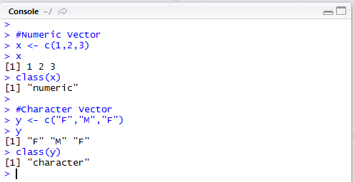
Data Structures
Vector
Values of all same data type
Numeric Character
1
M
2
F
3
M

Slide 14
Data Structures
Factor
Collection of values that have fixed set of possible values
Similar to vector
Represents categorical variables
M
F
M

Slide 15
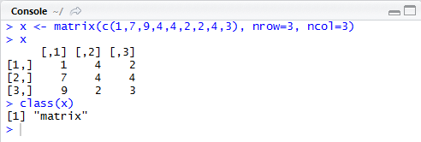
Data Structures
Matrices
Two-dimensional collection of values of same type
Array can extend this to more than two dimensions
1
4
2
7
4
4
9
2
3

Slide 16
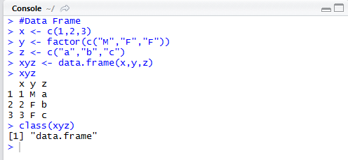
Data Structures
Data frames
Collection of vectors that all have same length
Columns can have different data types
Array can extend this to more than two dimensions
1
M
a
2
F
b
3
F
c

Slide 17
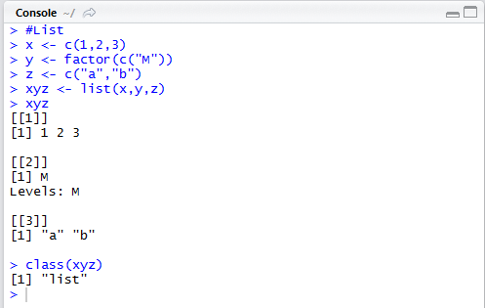
Data Structures
Lists
Similar to data frame, but columns can have varying lengths
1
M
a
2
b
3

Slide 18
Program Editor (Cont.)
Color codes are helpful, watch out for red
R functions and commands – blue
Options, data, variable names, ect. – black
Comments and text in quotation – green
(put # to start comment on line)
Error and warnings – red
Will appear in the console after running code
Color scheme can be customized under Tools <- global options

Slide 19
Log with errors vs. no errors
Error indicated in red, explains cause of error
Be careful, an error when changing object will result in object remaining the same as before

Slide 20
Things to Note When Writing Code
Syntax is case-sensitive
Typing in “data” to call an object named “Data” is wrong
Object names consist of letters, numbers, underscores “_” and periods “.”
You can use either ‘<-’ or ‘=‘ to assign objects value
a <- c(1,2,3)
a = c(1,2,3)
Functions can stand on their own or be an object
1 + 2
a <- 1 + 2
Important to consider later on when we do analyses

Slide 21
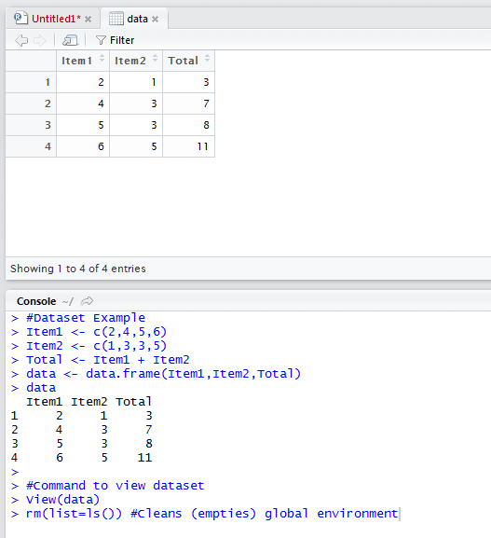
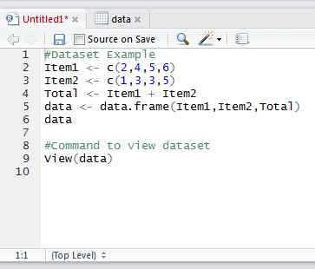
Let’s Practice!
Create the dataset (below) and view generated dataset
Input data directly into R
Run R Script

Slide 22
How To Import Data ?
Syntax
Import Dataset option

Slide 23
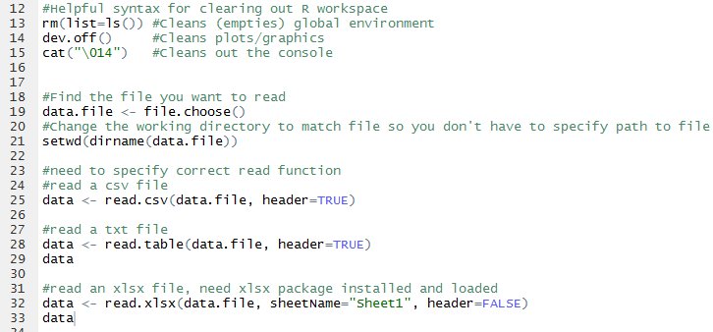
Importing Data Using Syntax
Example .csv import

Slide 24
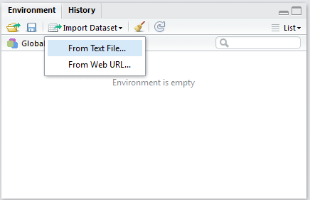
Import Data Option
Import dataset from text file

Slide 25
Import Data Option
Set object name
Set if headers part of dataset
*Note: can’t read in .xlsx files

Slide 26
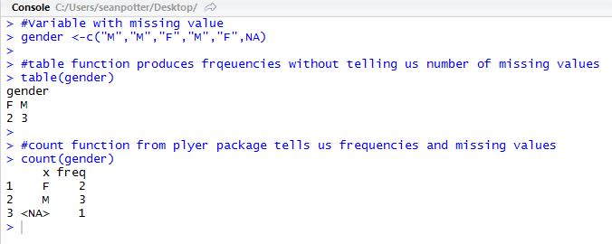
Check Frequencies
Often check frequencies with variables. Especially useful for categorical variables (sex, race)
R provides ‘table’ function to check frequencies
Doesn’t include missing values
Need to install ‘plyr’ package to access ‘count’ function

Slide 27
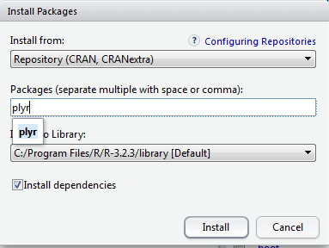
Installing Packages
Select Install
Set where package installed from, usually CRAN
Type out package name

Slide 28
Loading Packages
R doesn’t automatically load all available packages
Need to load additional packages into session
Two approaches
Find package in under package tab and check its box
Use library function

Slide 29
Load & Check Data
First, load up the example1 dataset included in module
Includes four variables
Employee ID (Employee)
Performance (Perf)
Conscientiousness (Conscale)
Sex
Use the ‘str’ command to check what the computer understands to be the contents of your data-this matters when you analyze (‘factor’ plots and adds differently than ‘integer’ or ‘number’)

Slide 30
Time to Plot Stuff!
The plot and hist functions present users with options to customize their graphs
I’ll show the basic graphs first
Then show the graphs with additional options I set

Slide 31
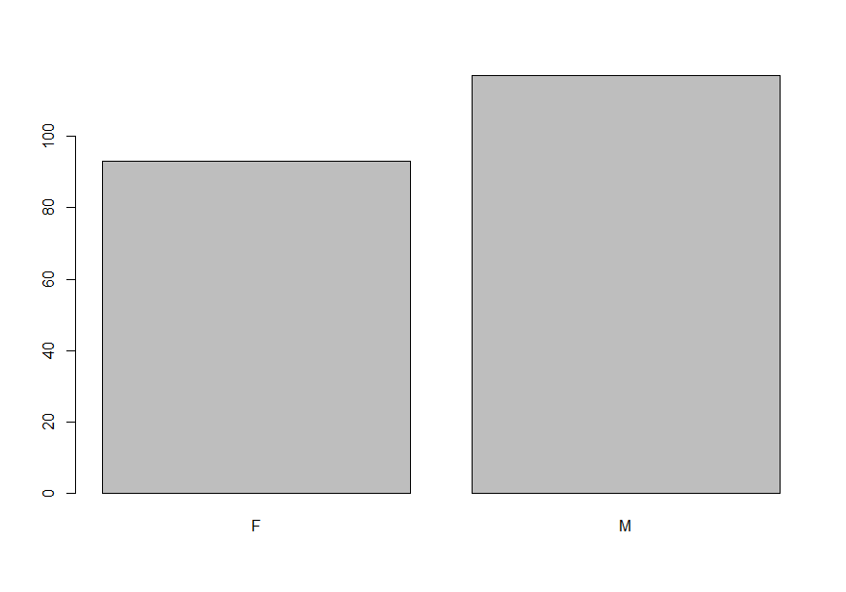
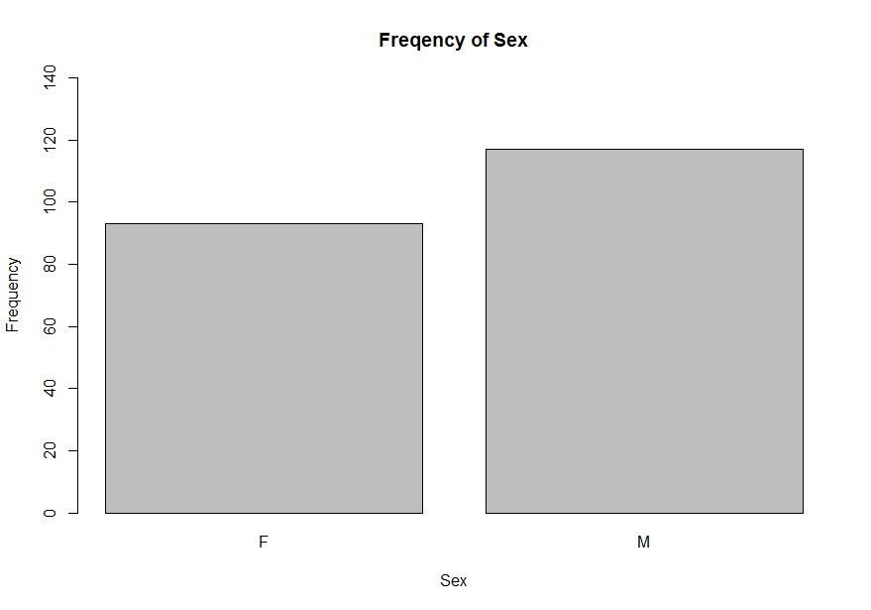
Basic Plot
R plots easily customized
Use help() on any function to learn about its options
Plot with added Options

Slide 32
Plot Numeric Frequencies
Can’t use plot function again
Will make a scatter plot of variable by each observation’s index (position in dataset) instead
Will require use of hist function instead

Slide 33
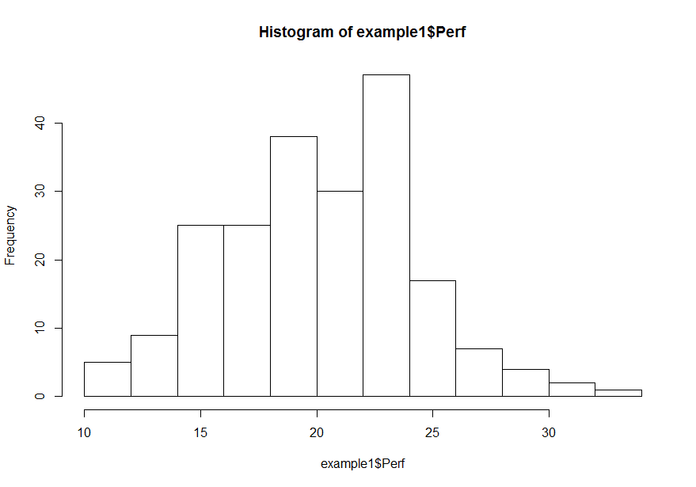
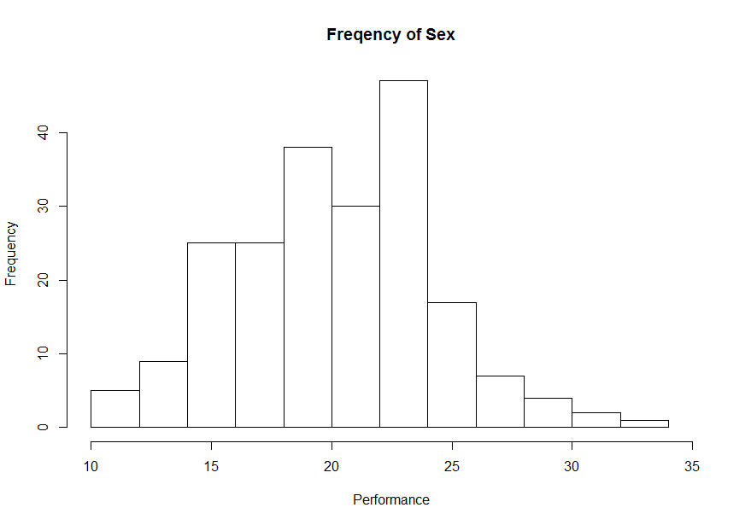
Basic Plot
Plot with added Options

Slide 34
Make a Scatterplot
We’ll use plot function again
Plot follows format of plot(x, y) by default
First object will go on x axis
Second object will go on y axis
You can specifically define the x and y variables however

Slide 35
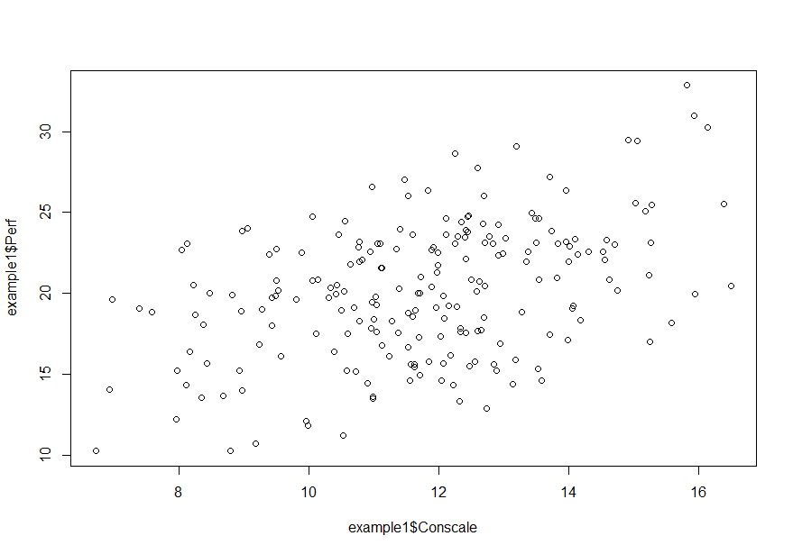
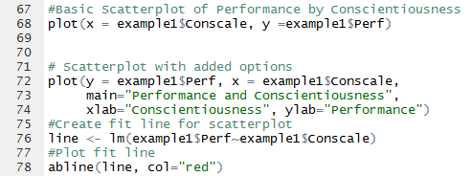
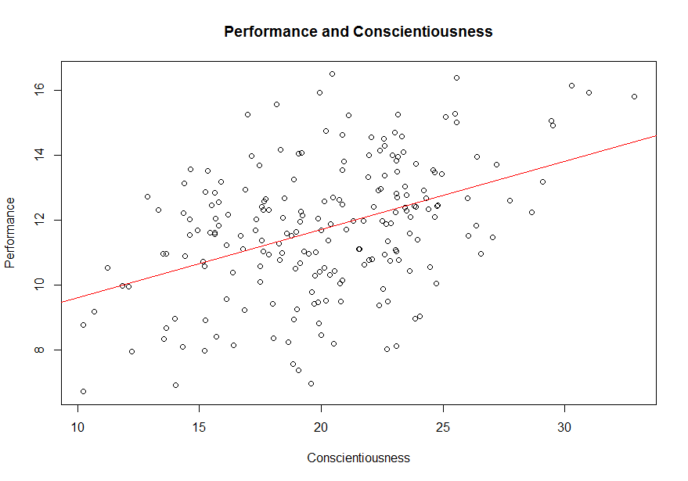
Basic Plot
Plot with added Options

Slide 36
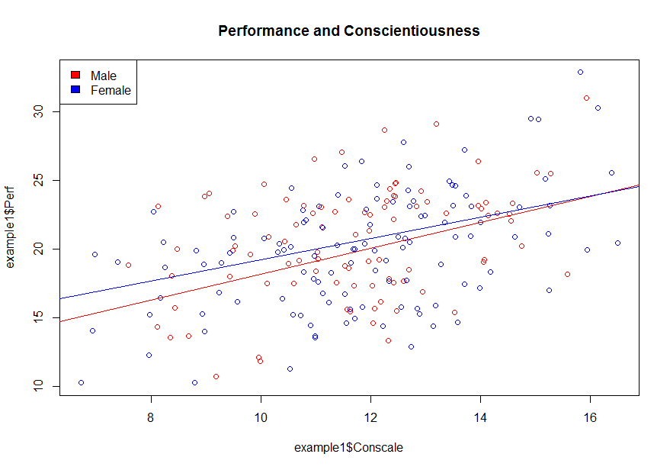
Plot by sex
Include legend

Slide 37
Assignment 1
Importing Excel and Text data files to R
Create very simple graphs and interpret them.
Not intended to be tricky or complicated
In Canvas → Assignments → Homework 1
Upload your clean R files to Canvas.
Turn in hardcopy of your answer for question 3, 4 and 5.

